Slide 1
Then Enlightenment and American Revolution

Slide 2
Philosophy in the Age of Reason
Go wondrous creatures! Mount where Science guides; Go measure earth, weigh air and state the tides; Instruct the planets in what orbs to run, Correct old time, and regulate the sun

Slide 3
Make Sure You Can Answer….
How was the Enlightenment linked to the Scientific Revolution?
What ideas about government emerged during the Enlightenment?
What ideas did Enlightenment thinkers support?

Slide 4
Make Sure You Can Define…
Natural laws
Social contract
Natural rights
Philosophe
Physiocrat
Laissez faire
Free market

Slide 5
A world of progress and reason
Thinkers such as Newton, and scientists like Jenner enjoyed great success…which led to great faith in reason
“the power of comprehending, inferring, or thinking especially in orderly rational ways”
Political thinkers worked to discover natural laws that governed human behavior, just like scientific principles governed the world.

Slide 6
Two Views on the Social Contract
John Locke
Thomas Hobbes

Slide 7
Two Views on the Social Contract
Believed people had Natural Rights
The best kind of government should be limited, and beholden to the people
People have the right to overthrow a government that violates the natural rights
Believed people were naturally cruel
Life in a state of nature is nasty, brutish, and short.
People entered into a social contract to protect themselves
Governments should be powerful to protect people
John Locke
Thomas Hobbes

Slide 8
What do you think?
Are people naturally good or bad?
Do people need protection from each other, or from the government?
Think of a school….are strict rules needed?

Slide 9
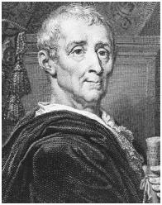
Baron de Montesquieu
Wrote The Spirit of the Laws
Believed in Separation of powers
Government should be divided, with each part having power over the other
This idea became the basis for the government of the United States.

Slide 10
The Philosophes
The philosophes were a group of enlightenment thinkers who wanted to improve society.
Voltaire used humor and sarcasm to point out abuse of power
Voltaire was imprisoned for his writings
“I may not agree with what you say, but I will defend to the death your right to say it.”

Slide 11
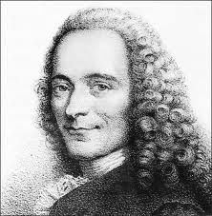
Voltaire
Let us read and let us dance - two amusements that will never do any harm to the world.
It is dangerous to be right in matters on which the established authorities are wrong.
I have never made but one prayer to God, a very short one: 'O Lord make my enemies ridiculous.' And God granted it.

Slide 12
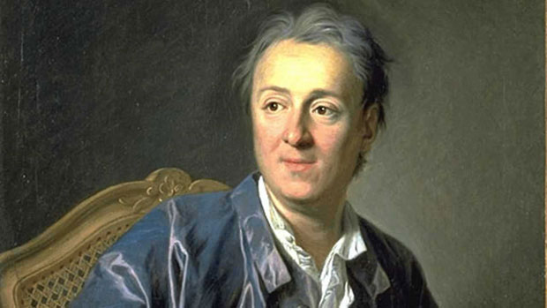
The Encyclopedia
Denis Diderot spent 28 years compiling a 28 volume encyclopedia
His goal was to “change the general way of thinking” by bringing knowledge to the masses
The books were banned in many countries, but still helped spread enlightenment ideas.

Slide 13
Rousseau
Believed people were basically good, but were corrupted by society
Believed that governments are only good if based on the consent of the governed
If people made their own laws, they would willingly obey them

Slide 14
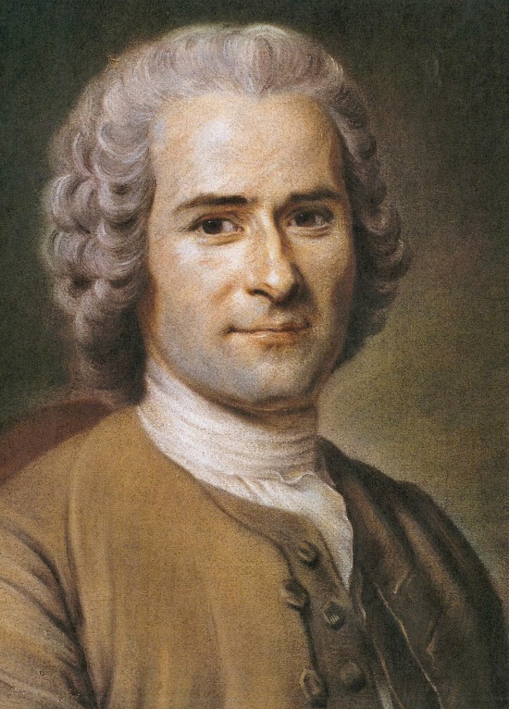
Jean Jacques Rousseau
Man is born free and everywhere he is in chains.
No man has any natural authority over his fellow men.
Insults are the arguments employed by those who are in the wrong.

Slide 15
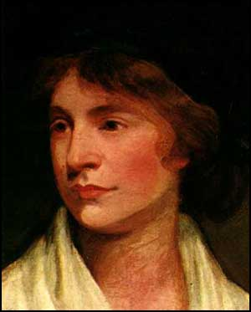
Limited Natural rights for Women
Many women argued, with little success, that natural rights applied to women as well
Mary Wollstonecraft called for equal education for boys and girls
She believed education was the key to equality for men and women

Slide 16
New Economic Thinking
Physiocrats were thinkers who focused on economic reform.
The new economic thinkers pursued a policy of laissez-faire, which called for business to operate without government interference.
British economist Adam Smith argued for the free market, the natural forces of supply and demand.

Slide 17
Make sure you can answer…
How was the Enlightenment linked to the Scientific Revolution?
What ideas about government emerged during the Enlightenment?
What ideas did Enlightenment thinkers support?

Slide 18
Make sure you can define…
Natural laws
Social contract
Natural rights
Philosophe
Physiocrat
Laissez faire
Free market

Slide 19
Enlightenment Ideas Spread
As Enlightenment ideas grew in popularity, traditional beliefs and customs were challenged

Slide 20
Make Sure You Can Answer…
How did Enlightenment ideas pose a challenge to the established order?
Why did some European rulers embrace Enlightenment ideas?
What ideas influenced artists and writers of the Enlightenment?
How did most people live during the age of reason?

Slide 21
Make Sure You Can Define…
Candide
Joseph II
Johann Sebastian Bach
George Frederick Handel
Wolfgang Amadeus Mozart
Daniel Defoe
Salon
Enlightened despot
baroque

Slide 22
The Challenge of New Ideas
Achieving a just society
During the Middle Ages, people had accepted divine right, absolute rulers. This was no longer the case
People began to call for a just society that would
Ensure material well being
Ensure Social Justice
Ensure happiness

Slide 23
The Challenge of New Ideas Continued…
Censorship
Government and Church officials believed the old order had been set up by God, and it was their duty to protect it
To protect the old order, they waged a war of Censorship
Books were burned
Books were banned
Writers were imprisoned
Some writers disguised their works as fiction, such as The Candide, which showed the need for change

Slide 24
Salons
The spread of new ideas was helped by informal discussion held in places called Salons.
Here Middle Class citizens were on equal footing when they discussed ideas with nobles.

Slide 25
The Salons in Rue Saint Honore
One of the most famous Salons was operated by Madame Geoffrin, against her husband’s wishes
She entertained people such as Mozart and Diderot.
She wrote letters to Catherine II of Russia and Maria Theresa of Austria.
Salons such as this helped women become educated in a time with no schools

Slide 26
Enlightened Despots
Philosophers tried to convince absolute rulers to adopt the ideas of the Enlightenment. They hoped this would bring about reform.
Rulers who accepted enlightenment ideas were known as enlightened despots.
(despot: a king or other ruler with absolute, unlimited power)

Slide 27
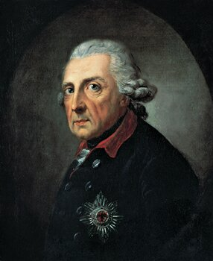
Frederick The Great
Ruled Prussia from 1740-1786
Exerted tight control over his subjects

Slide 28
How was Frederick The Great Enlightened?
Had Voltaire develop a Prussian academy of Science
Distributed tools and seed to help peasants farm.
Tolerated Religious Freedom
“In my kingdom, everyone can go to heaven in his own fashion”
Frederick’s reforms ultimately gave him more power.

Slide 29
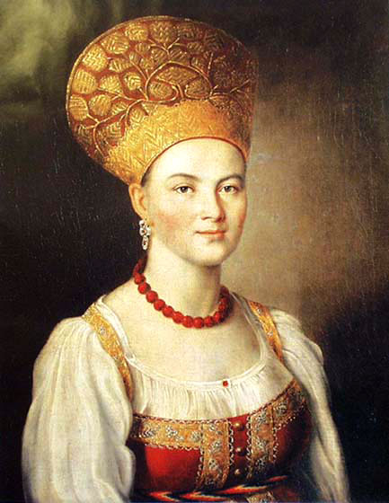
Catherine the Great
Began her rule in Russia in 1762

Slide 30
How was Catherine the Great Enlightened?
She exchanged letters with Voltaire and Diderot
She granted nobles a charter of rights
She spoke out against serfdom
However, in the end, Catherine allied with the nobles against the serfs when a revolt broke out.

Slide 31
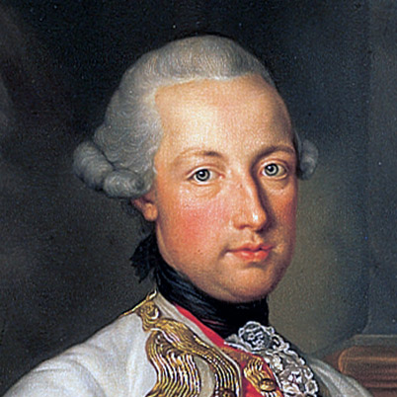
Joseph II
Ruler of Austria

Slide 32
How was Joseph II Enlightened?
He traveled in disguise among the peasants to learn of their problems.
Chose middle class citizens rather than nobles to head departments
Was tolerant of religions such as Judaism and Catholicism
Ended Censorship, abolished serfdom
Joseph’s reforms were ended after he died

Slide 33
The arts and Literature
Art, music, and literature evolved to meet changing tastes, just like today.
How has art, music, and literature changed in your lifetime?

Slide 34
Courtly Art
The tastes of the nobles changed from the classical or baroque style to the rococo style.
People now favored art and decorations that were more simplified, and less ornate

Slide 35
Middle Class Audiences
People who such as successful merchants or town officials wanted their portraits painted, but without frills.
Middle Class audiences liked paintings of family life, or realistic scenes from their town or in the countryside

Slide 36
Trends in Music
Some important musical figures of the time period were
Johann Sebastian Bach
George Frederick Handel
Wolfgang Amadeus Mozart

Slide 37
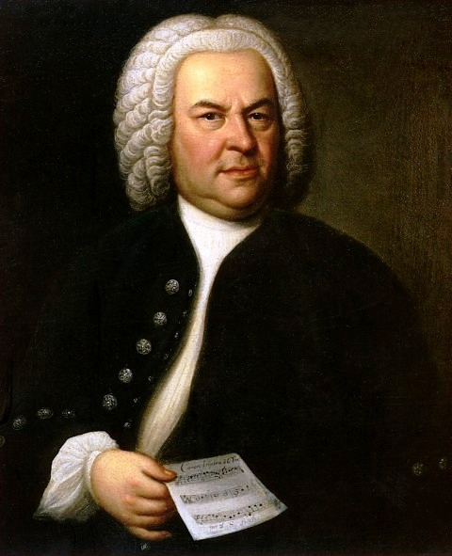
Johann Sebastian Bach: Brandenburg Number Three

Slide 38
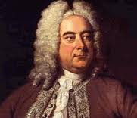
George Frederick Handel: Water Music

Slide 39
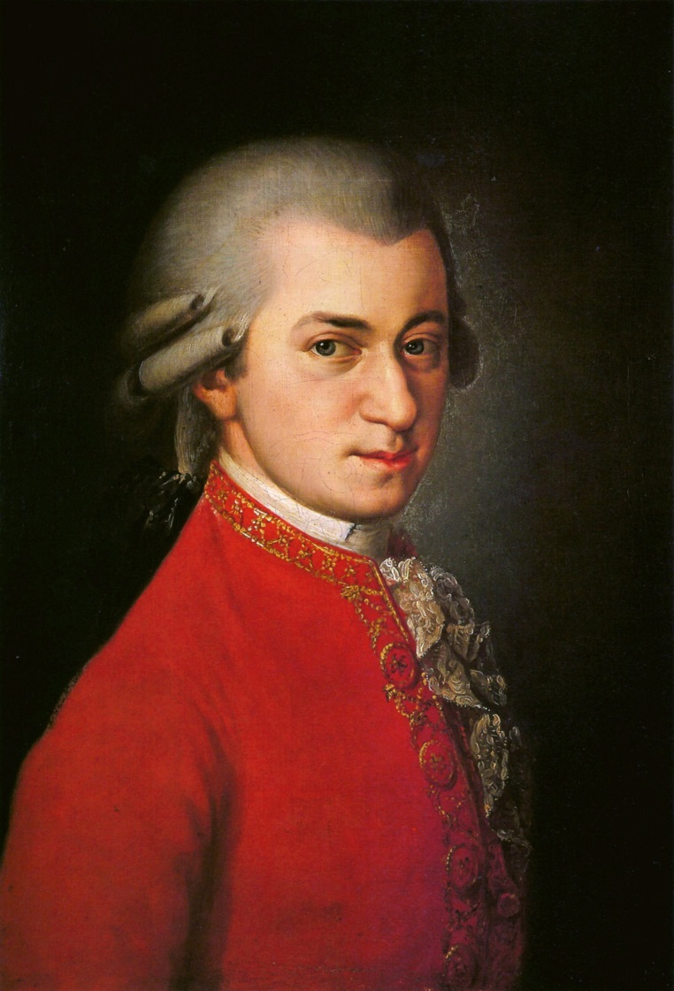
Wolfgang Amadeus Mozart: Night Music

Slide 40
The Novel
Literature developed a new audience
Middle Class readers liked stories written in simple prose, that told stories they could relate to.

Slide 41
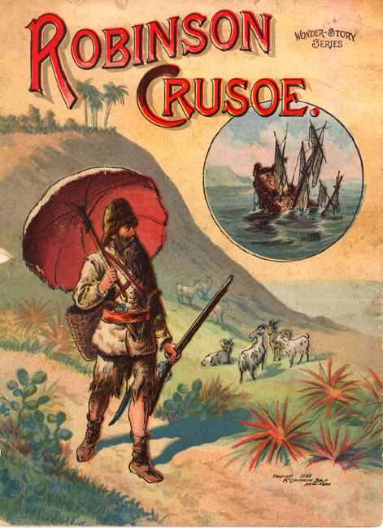
Novels
Told the story of a man shipwrecked on an Island, written by Daniel Dafoe

Slide 42
Lives of the Majority
Conditions West and East
Peasant life varied across Europe. In the west serfdom had disappeared, while in the east it continued
Old Ways Survive
Although new ideas about freedom and democracy were spreading, change would be a long time off

Slide 43
Make Sure You Can Answer…
How did Enlightenment ideas pose a challenge to the established order?
Why did some European rulers embrace Enlightenment ideas?
What ideas influenced artists and writers of the Enlightenment?
How did most people live during the age of reason?

Slide 44
Make Sure You Can Define…
Candide
Joseph II
Johann Sebastian Bach
George Frederick Handel
Wolfgang Amadeus Mozart
Daniel Defoe
Salon
Enlightened despot
baroque

Slide 45
Britain at Mid-Century
“Foreign trade is the honor of the kingdom the noble profession of the merchant…the supply of our wants, the employment of our poor, the improvement of our lands, the nursery of our sailors, the walls of the kingdom, the means of our trade, the sinews of our wars, the terror of our enemies.”

Slide 46
Make Sure You Can Define…
Act of Union
Tories
Whigs
Robert Walpole
George III
Constitutional government
Prime minister

Slide 47
Make Sure You Can Answer…
Why did Britain become a global player in the 1700s?
What new political institutions emerged in Britain in the 1700s?
What groups held political power in Britain?

Slide 48
Great Britain
The United Kingdom of Great Britain and Northern Ireland is made up of four regions
England
Wales-Conquered in 1284
Scotland-Joined by the Act of Union in 1707
Northern Ireland-joined/conquered 1921

Slide 49
Global Expansion
Britain rose to prominence in the world due to several reasons
Geography
During the 1500s and 1600s England established settlements all over the world. West Indies, North America, and India were notable.
England had conquered Wales in 1284,

Slide 50
Global Expansion

Slide 51
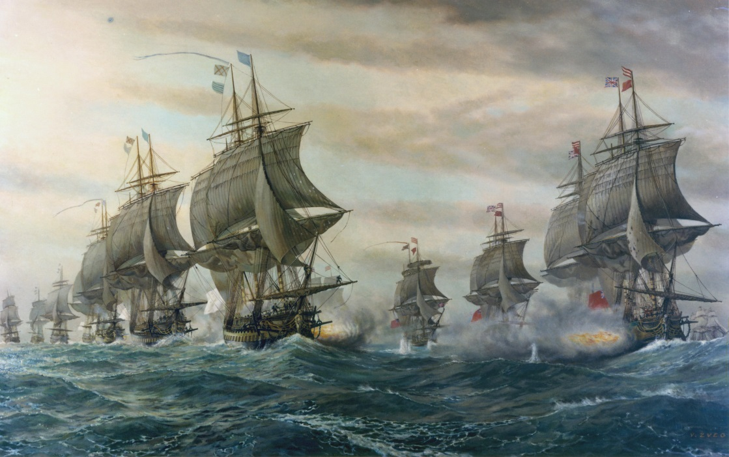
Global Expansion
Success in War
Starting in 1588, Britain was on the winning side of most wars, resulting in gains in territory and a more powerful navy

Slide 52
Global Expansion
A favorable business climate
Britain places fewer restrictions on trade than other countries did
As a result, British companies grew to be very successful

Slide 53
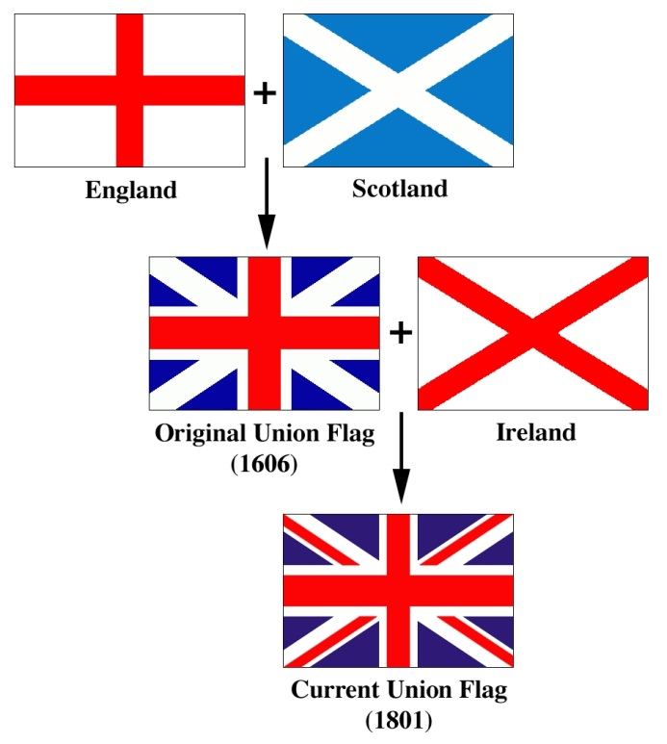
Union with Scotland
1707: England and Scotland merged with the Act of Union
The union helped trade pass freely
The Union created a larger market for goods

Slide 54
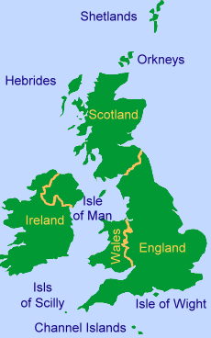
Ireland
England had controlled Ireland since the 1100s
England had tried to increase the number of protestants that lived in Ireland, this was met with great resistance from the Irish.

Slide 55
British Union….

Slide 56
Growth of Constitutional Government
England’s government evolved from a monarchy to a constitutional government
The British constitution is made up of:
all acts of parliament.
Magna Carta
Bill of Rights
Unwritten traditions

Slide 57
Political Parties
A political party is an organization to gain governmental control
In Great Britain, there were two main political parties.
Can You name the two main political parties in the U.S?

Slide 58
Political Parties
Backed more liberal policies
Supported religious toleration
Supported the power of parliament over the crown
Generally were urban business owners
Generally land owning aristocrats
Wanted to preserve older traditions
Supported broad royal power and a powerful Anglican Church
Whigs
Tories

Slide 59
Cabinet System
In 1714 King George I came to the throne of Britain. He was German, and spoke no English.
George I, and his son George II, relied on a small group of advisors, known as the cabinet.
The cabinet got its name from the small room they met in, and over time became official, and remained in power as long as the House of Commons agreed.

Slide 60
American Cabinet
Secretary of State John Kerry
Secretary of the Treasury Jacob Lew
Secretary of Defense Chuck Hagel
Attorney General Eric Holder
Secretary of the Interior Sally Jewell
Secretary of Agriculture Tom J. Vilsack
Secretary of Commerce Penny Pritzker
Secretary of Labor Thomas E. Perez
Secretary of Health and Human Services Kathleen Sebelius
Secretary of Housing and Urban Development Shaun Donovan
Secretary of Transportation Anthony Foxx
Secretary of Energy Ernest Moniz
Secretary of Education Arne Duncan
Secretary of Veterans Affairs Eric Shinseki
Secretary of Homeland Security Rand Beers (acting)

Slide 61
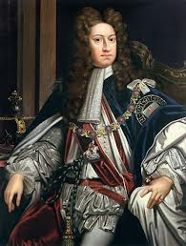
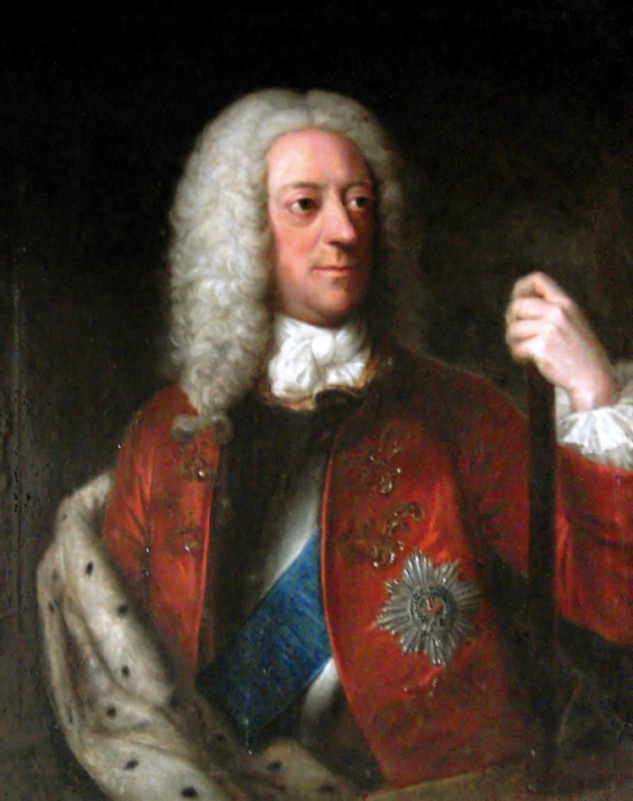
Kings
George I
George II

Slide 62
Prime Minister
The head of the cabinet was called the prime minister
The prime minster is the head of the majority party in parliament, and the chief executive in Britain.
Robert Walpole is known as Britain’s first prime minister and molded the cabinet into a unified powerful force.

Slide 63
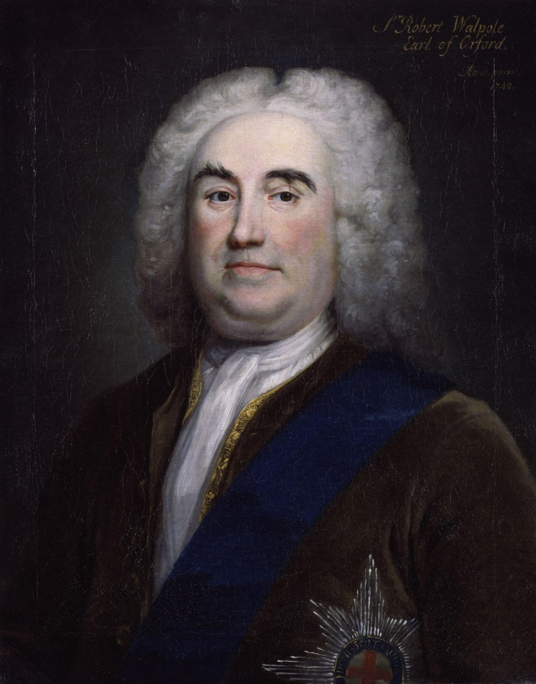
Robert Walpole

Slide 64
Politics and Society
The Ruling Elite
Traditionally made up of the landowning aristocrats
Highest Nobles held seats in the House of Lords
Wealthy landowners controlled elections to the House of Commons
Only property owners were allowed to vote
Other Classes
Most people were very poor, with almost no food as their land was lost to the wealthy
A growing middle class helped usher in the Industrial Revolution (Ch. 3)

Slide 65
King George III

Slide 66
George III Reasserts Royal Power
Came to the throne in 1760
George III wanted to:
Reassert royal power
End Whig domination
Choose his own ministers
Dissolve the cabinet system
Make the House of Commons follow his will

Slide 67
George III
George III and his allies in Parliament tried to make colonists pay taxes
This action led to the American Revolutionary War
After the loss in the American Revolution, cabinet rule was restored in 1788.

Slide 68
Make Sure You Can Answer…
Why did Britain become a global player in the 1700s?
What new political institutions emerged in Britain in the 1700s?
What groups held political power in Britain?

Slide 69
Make Sure You Can Define…
Act of Union
Tories
Whigs
Robert Walpole
George III
Constitutional government
Prime minister

Slide 70
Birth of the American Republic
‘Tis repugnant to think, to the universal order of things, to all examples of former ages, to suppose that this continent can long remain subject to any external power”
-Thomas Paine

Slide 71
Make Sure You Can Answer….
How were the 13 British Colonies part of a global empire?
Why did colonists come to resent British rule?
How did Enlightenment ideas influence Americans?
What was the global impact of the American Revolution?

Slide 72
Make Sure You Can Define…
Navigation Acts
Continental Congress
George Washington
Thomas Jefferson
Battle of Saratoga
Treaty of Paris of 1783
Bill of Rights

Slide 73
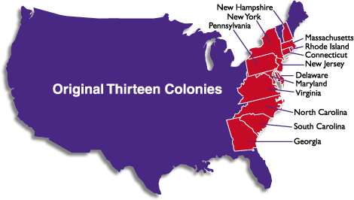
The 13 British Colonies
New Hampshire
Massachusetts
New York
Pennsylvania
Rhode Island
Connecticut
New Jersey
Delaware
Maryland
Virginia
North Carolina
South Carolina
Georgia

Slide 74
The 13 British Colonies
By 1750, the 13 colonies were well established and prosperous.
Britain had adopted some mercantilist policies, like the Navigation Acts, but they were rarely enforced.
Some people did not even consider smuggling a crime

Slide 75
13 Colonies
The Colonies were home to diverse ethnic and religious groups
Social distinctions were blurred.
Colonists felt that they should have the same rights as other British Subjects

Slide 76
Growing Discontent
After Britain won the 7 Years War, which included the French and Indian War, they wanted the colonists to help pay the bill.
Colonists were unhappy with the new laws.
“No taxation without representation!”

Slide 77
Early Clashes
1770 Boston Massacre:-British soldiers fired into a crowd of angry colonists, killing five of them
1773: Boston Tea Party- Colonists boarded three ships in Boston Harbor and dumped the tea they were transporting into the Ocean
As a result, Parliament passed harsh laws designed to punish, which made the colonists angry

Slide 78
Fighting Begins
In April of 1775, Colonial Militia and British soldiers fought at Lexington and Concord
This battle kickstarted the Revolutionary War
The Colonists were led by men such as…

Slide 79
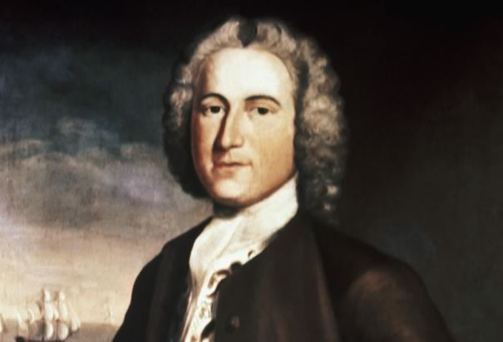
John Adams
“I must study politics and war that my sons may have liberty to study mathematics and philosophy”.

Slide 80
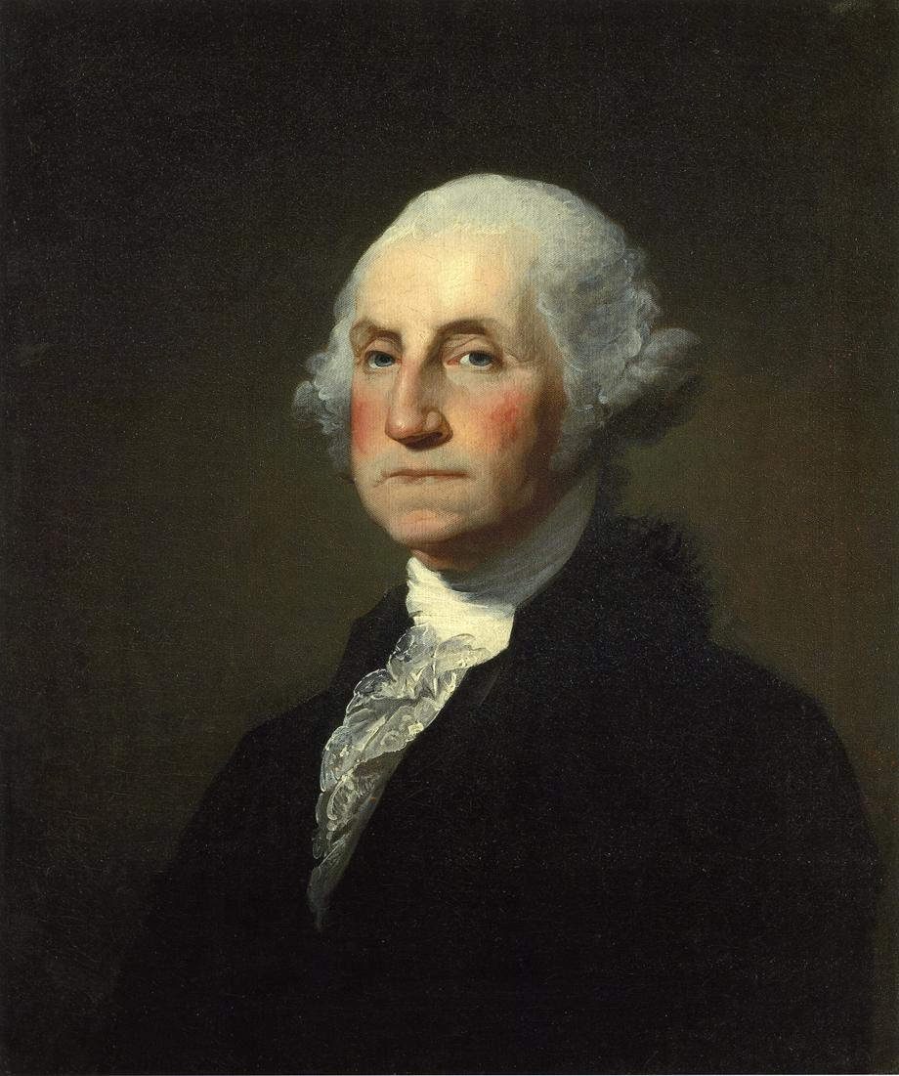
George Washington
“Associate with men of good quality if you esteem your own reputation; for it is better to be alone than in bad company.”

Slide 81
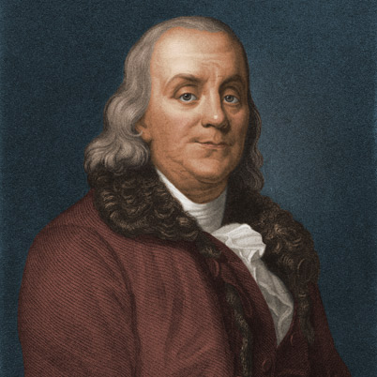
Ben Franklin
“It takes many good deeds to build a good reputation, and only one bad one to lose it.”
“He that is good for making excuses is seldom good for anything else.”

Slide 82
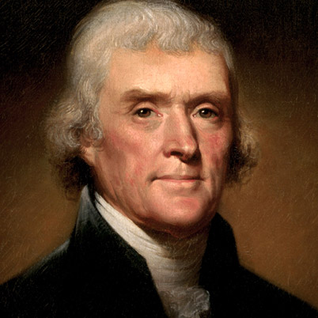
Thomas Jefferson
“When angry count to ten before you speak. If very angry, count to one hundred.”
“Honesty is the first chapter in the book of wisdom.”

Slide 83
Declaring Independence
On July 4th, 1776, American Colonists declared that they were an independent country.
“We hold these truths to be self-evident, that all men are created equal, that they are endowed by their creator with certain inalienable rights, that among these are life, liberty, and the pursuit of happiness”
Which enlightenment thinker most influenced the ideas behind the Declaration?

Slide 84
The American Revolution
Britain had the most powerful military in the world, the Americans had an untrained all volunteer force.
The Americans used their knowledge of the land as well as guerilla tactics.
Britain controlled the major cities, the Americans controlled the countryside

Slide 85
The French Alliance
After a victory at the Battle of Saratoga, the French allied with the Americans
The French army helped reinforce the Americans, and the French Navy battled the British on the water.
George Washington led the American army through very difficult times.

Slide 86
Treaty of Paris
The British surrendered at Yorktown, VA in 1781.
Following the surrender, Great Britain recognized the Independence of the United States of America

Slide 87
A New Constitution
The new country’s system of government was set up by the Constitution
The framers of the constitution were influenced by Locke, Rousseau, and Montesquieu.
The federal government’s power was divided into three branches
Power was shared with the states
Individual freedom was protected by the Bill of Rights

Slide 88
Limited Freedom
Most Americans at this time could not vote
Slavery still existed
Native Americans suffered from harsh treatment
Global Impact
The U.S government under the Constitution was the most liberal of its day
Many countries were influenced by the consitution

Slide 89
Make sure you can answer…
How were the 13 British Colonies part of a global empire?
Why did colonists come to resent British rule?
How did Enlightenment ideas influence Americans?
What was the global impact of the American Revolution?

Slide 90
Make sure you can define…
Navigation Acts
Continental Congress
George Washington
Thomas Jefferson
Battle of Saratoga
Treaty of Paris of 1783
Bill of Rights

