Slide 1
Big Business and Wealth
1875-1900ish: The Gilded Age

Slide 2
The Theory of Capitalism
“Capitalism” is the belief that building wealth is a good thing for individuals and for society.
Capitalism is one of the foundations of the USA.
Adam Smith was the philosophe who came up with the term.
In theory, the wealthy employer treats his workers well because doing so benefits him. How?
A happy worker works more productively!

Slide 3
Example of “good” capitalism:
John Cadbury started selling coffee, tea, and chocolate in 1824.
He housed his workers on a model estate that he built with his own money. He provided…
Education.
Healthcare.
Housing.
Stores with low prices.
Reasonable hours.
Because of this, the workers cared about the company and worked harder.
The result: Cadbury is now a company worth eleven billion pounds!!!!

Slide 4
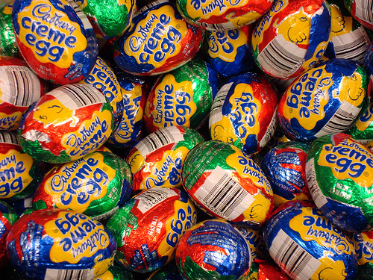

Slide 5
The Reality of Capitalism
Most capitalists weren’t as responsible as Cadbury. These became known as “robber-barons.”
The urge to squeeze as much profit as possible out of their companies led to…
Low wages.
Inferior materials used in products.
MASSIVE wealth for the owners.
For the owners, life looked like this:

Slide 6
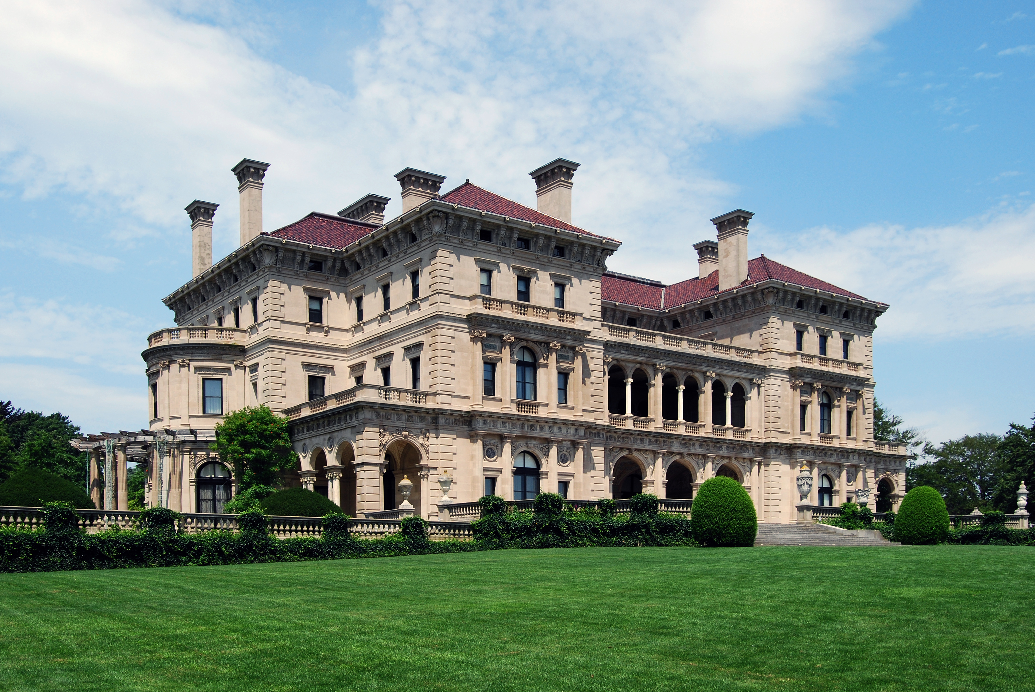
This is The Breakers in Newport, RI. The Vanderbilts, a railroad family, lived here about two and a half months out of every year. The house was empty the rest of the time.

Slide 7
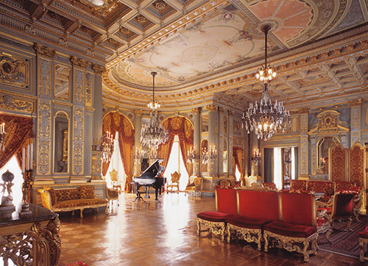

Slide 8
The Reality of Capitalism
Most capitalists weren’t as responsible as Cadbury. These became known as “robber-barons.”
The urge to squeeze as much profit as possible out of their companies led to…
Low wages.
Inferior materials used in products.
MASSIVE wealth for the owners.
For the owners, life looked like this:
For the workers, it looked more like this:

Slide 9
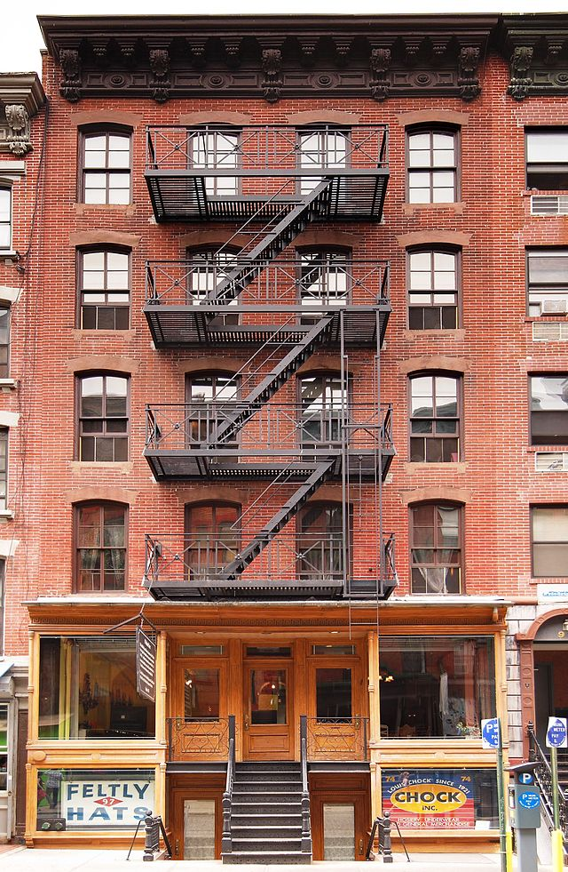
This is the Tenement Museum on New York’s Lower East Side. Each floor might have been occupied by two or three families.

Slide 10
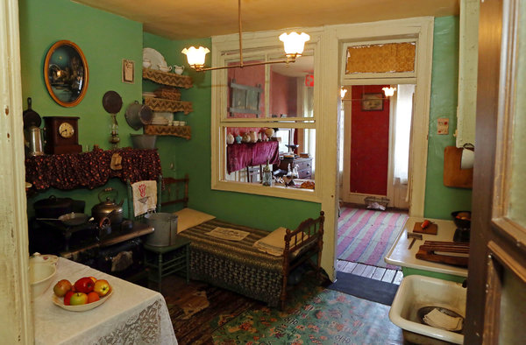

Slide 11
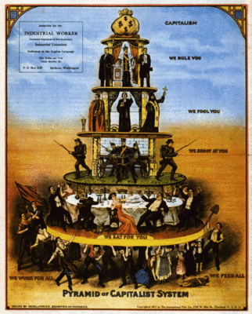
Social Darwinism
Darwin’s theories said that the “fittest” traits would survive in species.
Example: wisdom teeth.
The “social” side claims that the hardest workers, the cleverest inventors, and the luckiest entrepreneurs will gain the most money.
What happens to the rest?
What government philosophy says that the government should regulate businesses as little as possible?

Slide 12
Monopolies and Trusts
A REALLY successful business will slowly begin to gobble up what we call “market share.”
Market share: a fraction of the available consumer dollars.
This is a good thing to “pure” capitalists: it’s how capitalism is supposed to work.
The best product makes the most money; the company uses that money to make more products, and so on.
The downside: newer entrepreneurs have a hard time breaking into the industry. Then they complain. Then they lobby the government to pass a law that protects them:
The Sherman Antitrust Act!

Slide 13
The Sherman Act in Action:
Back in April 2012, Apple went to five book publishers with a secret plan to fix the prices of e-books in the iBookstore.
The idea was that Apple would make 30% of the price of each book, with the publisher making the other 70%.
Prices would be fixed at below what Amazon charged.
Amazon can charge less because of economies of scale!
This didn’t allow the market (consumers) to set the price of e-books, so the government sued Apple.
Result: Apple was going to lose. Big. So Apple settled for many, many millions of dollars.

Slide 14
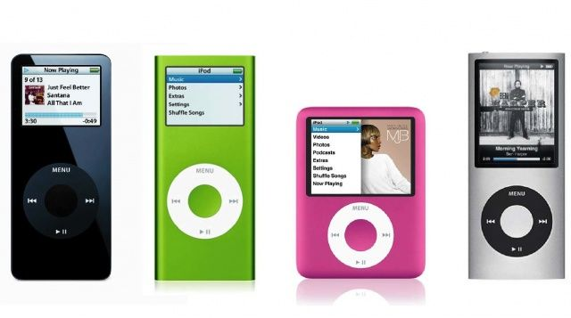
Integration
Let’s look at Apple again:
Apple makes iPods.
A small company somewhere makes the little circle thingies that allow you to control iPods.
This company has a patent on the circle thingies, so Apple can’t make their own.
Apple has two choices:
Invent a new circle thingie that VERY CAREFULLY avoids the thingie company’s patents. It’ll cost a lot of money to do this, and it might not work anyway.
Simply buy the thingie company and gain control of the patents.
Apple did a cost-benefit analysis, bought the company, and moved on with its life.
This is an example of horizontal or vertical integration?
How would we make this horizontal?

Slide 15
So, what does this have to do with me?
ANYTHING that involves businesses, labor regulation, or monopolies also affects prices.
Usually, government regulations lead to price increases.
Generally, Republicans dislike regulations; Democrats like them.
We’re currently living through another Gilded Age.

