Slide 1
DYSTOPIA
Definition, Traits, Controls

Slide 2
UTOPIA vs. DYSTOPIA
Utopia: A place, state, or condition that is ideally perfect in respect of politics, laws, customs, and conditions.
Dystopia: A futuristic, imagined universe in which oppressive societal control and the illusion of a perfect society are maintained through corporate, bureaucratic, technological, moral, or totalitarian control. Dystopias, through an exaggerated worst-case scenario, make a criticism about a current trend, societal norm, or political system.

Slide 3
Dystopian Fiction
In most dystopian fiction, a corrupt government creates or sustains the poor quality of life, often conditioning the masses to believe the society is proper and just, even perfect.
Dystopias are frequently written as warnings, or as satires, showing current trends extrapolated to a nightmarish conclusion.

Slide 4
Common Traits
a hierarchical society where divisions between the upper, middle and lower class are definitive and unbending (Caste system)
2. a nation-state ruled by an upper class with few democratic ideals
---Including state propaganda programs and educational systems that coerce most citizens into worshipping the state and its government, in an attempt to convince them into thinking that life under the regime is good and just

Slide 5
Common traits
3. strict conformity among citizens and the general assumption that dissent and individuality are bad
4. a fictional state figurehead that people worship fanatically through a vast personality cult

Slide 6
Common Traits
5. a fear or disgust of the world outside the state
6. a common view of traditional life, particularly organized religion, as primitive and nonsensical
7. a penal system that lacks due process laws and often employs psychological or physical torture

Slide 7
Common Traits
8. constant surveillance by state police agencies
9. the banishment of the natural world from daily life
10. a back story of a natural disaster, war, revolution, uprising, spike in overpopulation or some other climactic event which resulted in dramatic changes to society

Slide 8
Common Traits
11. a standard of living among the lower and middle class that is generally poorer than in contemporary society
12. a protagonist who questions the society, often feeling intrinsically that something is terribly wrong

Slide 9
The Protagonist
often feels trapped and is struggling to escape.
questions the existing social and political systems.
believes or feels that something is terribly wrong with the society in which he or she lives.
helps the audience recognize the negative aspects of the dystopian world through his or her perspective.

Slide 10
EFFECT & Purpose
Familiarity is used to have an effect on the reader. It is not enough to show people living in a society that seems unpleasant. The society must have echoes of today, of the reader's own experience.
Authors often use a dystopia effectively to highlight their own concerns about societal norms, current trends or political systems.

Slide 11
Types of dystopian controls
Corporate control: One or more large corporations control society through products, advertising, and/or the media.
Bureaucratic control: Society is controlled by a mindless bureaucracy through a tangle of red tape, relentless regulations, and incompetent government officials.

Slide 12
Types of dystopian controls
Technological control: Society is controlled by technology—through computers, robots, and/or scientific means.
Philosophical/religious control: Society is controlled by philosophical or religious ideology often enforced through a dictatorship or theocratic government.

Slide 13
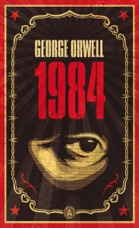
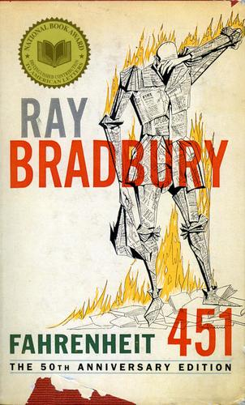
DYSTOPIAN NOVELS

Slide 14
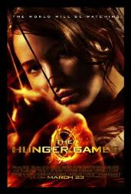
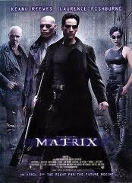
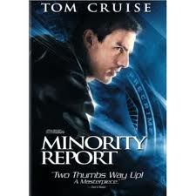
Dystopian movies

