Slide 1
Revolutions in Europe and Latin America
1790-1848

Slide 2
Chapter Outline
Section One
An Age of Ideologies
Pages 112-114
Section Two
To the Barricades!
Pages 115-120
Section Three
Latin American Wars of Independence
120-127

Slide 3
An Age of Ideologies
“Kings have to calculate the chances of their very existence in the immediate future. Passions are let loose and together to overthrow everything that society rejects as the basis of its existence: religion, public morality, laws, customs, rights, and duties, all are attacked, confounded, overthrown or called into question.”-Clemens von Metternich

Slide 4
Make Sure You Can Answer…
How did the goals of conservatives and liberals differ?
How did Nationalism pose a challenge to the old order?
Why was Europe plagued by constant unrest after 1815?

Slide 5
Make Sure You Can Define…
Conservatives
Liberals
Nationalists
Ideology
Universal manhood suffrage
autonomy

Slide 6
Preserving the Old Order
The Congress of Vienna (chapter 2) was a victory for Conservatives, people who:
Monarchs, members of the government, nobles, church leaders
Supported the system that had been attacked under the French Revolution.
Some peasants who wanted to preserve the old order

Slide 7
Preserving the Old Order
Goals
To remake Europe as it had been prior to 1789.
Restore the power of royal families that had been ousted by Napoleon
Re-establish the social hierarchy
Re-establish the authority of the Church

Slide 8
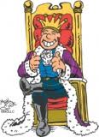
Preserving the Old Order
Attitude toward Change
Conservatives thought that ideas such as Natural Rights (chapter one) led to chaos.
They believed that their way was best for them, and all people of Europe.
They opposed freedom of the press
They wanted to suppress revolutionary ideas

Slide 9
The Liberal Challenge
People who were of a different ideology than the conservatives were called liberals. They:
Embraced enlightenment ideas
Spoke against divine right
Defended natural rights

Slide 10
The Liberal Challenge
Political Ideas
Governments based on written constitutions with separation of powers.
Government should protect basic rights such as free speech, thought, and religion
Only male property owners should vote
Later in the century, liberals adopted the idea of universal manhood suffrage.

Slide 11
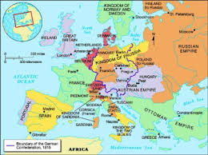
Nationalist Stirrings
Nationalism
European rulers had won and lost lands in war and exchanged territories and people as a result of those wars.
Empires like Austria, Russia, and Ottoman Empire controlled diverse people.

Slide 12
Nationalist Stirrings
Nationalism Goals
Unifying and gaining independence for people with a common heritage
Giving each national group its own state
Nationalism had negative effects: breeding intolerance and persecution of national and ethnic minorities.

Slide 13
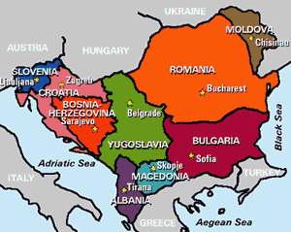
Nationalist Stirrings
Revolts in the Balkans
The Balkans are an area in southeastern Europe, and are home to many ethnic groups

Slide 14
Nationalist Stirrings
Revolts in the Balkans
The first Balkan revolt occurred between 1804 and 1817 when the Serbs revolted against the Ottomans.
In the end the Serbian people achieved autonomy
The struggle fostered a sense of Serbian identity, and a revival of Slavic literature and culture.

Slide 15
Nationalist Stirrings
Independence of the Greeks
In 1821 the Greeks revolted against Ottoman rule
The Greeks appealed to the West, and Britain, France, and Russia forced the Ottomans to grant independence to the Greeks
Europeans had greatly admired ancient Greek civilization

Slide 16
Challenges to the Old Order
In The 1820s revolts erupted in Spain, Portugal, and Italy
Conservative armies fought against the rebels.
As workers began to revolt along with nationalists, the old order was under further attack.

Slide 17
Make Sure You Can Answer…
How did the goals of conservatives and liberals differ?
How did Nationalism pose a challenge to the old order?
Why was Europe plagued by constant unrest after 1815?

Slide 18
Make Sure You Can Define…
Conservatives
Liberals
Nationalists
Ideology
Universal manhood suffrage
autonomy

Slide 19
To The Barricades!
“We are sleeping on a volcano. Do you not see that the Earth trembles anew? A wind of revolution blows, the storm is on the horizon.” –Alexis de Tocqueville

Slide 20
Make Sure You Can Answer…
Why did revolts break out in France in 1830 and 1848?
How did revolutions in France affect other parts of Europe?
Why did the revolts of 1830 and 1848 generally fail to achieve their goals?

Slide 21
Make Sure You Can Define…
Charter of French liberties
Charles X
Louis Phillipe
Louis Napoleon
Louis Kossuth
Frankfurt Assembly

Slide 22
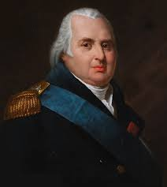
France After the Restoration
Louis XVIII
Made king after the Congress of Vienna
Issued the Charter of French Liberties
Was not an absolute ruler, still had a great deal of power

Slide 23
France After the Restoration
Efforts at Compromise
Louis XVIII tried to appease the people of France, but was unsuccessful
Ultraroyalists did not like the constitutional monarchy and wanted the old regime to return.
Liberals wanted to extend suffrage and gain power
Radicals wanted a republican government
Working class people wanted a decent wage.

Slide 24
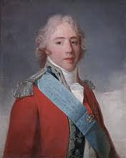
France After the Restoration
Charles X
Inherited the throne after his brother, Louis XVIII died.
Believed in absolutism.
Suspended the legislature, limited the right to vote, restricted the press.

Slide 25
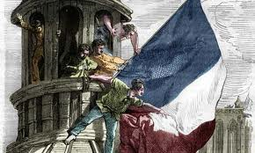
France After the Restoration
The July Revolution
The people of France were FURIOUS with Charles X
Citizens revolted and took over Paris
Charles X abdicated and fled to England
A new King was chosen by the lower house of the Legislature

Slide 26
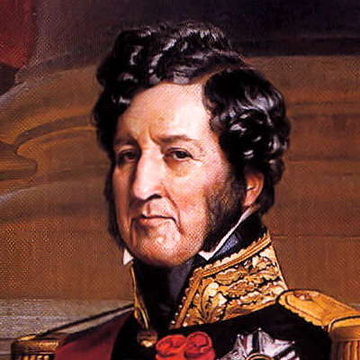
France After the Restoration
Louis Phillipe was made the new King
Cousin of Charles X
Called the “Citizen King”
Policies made him popular, but favored the middle class at the expense of the workers.

Slide 27
The French Revolution of 1848
Discontent with the French government grew
Radicals formed secret societies working to bring about a republic
Utopian Socialists wanted to end private property
Liberals denounced the government of Louis Phillipe for corruption
THEN…..
Economic slump shut down factories
Harvests were poor
People lost their jobs and food prices soared
The government was plagued by scandals

Slide 28
France After the Restoration
The government responded violently to protestors
Louis Phillipe abdicated
A new government called the second republic was established, but with controversy.
The wealthy gained control of the government
After an employment program was ended, the poor protested.
There was a deep seated resentment among the people of France.
February Days
June Days

Slide 29
France After the Restoration
The National Assembly took control and created a constitution.
Created a strong president and one-house legislature
Gave the right to vote to all adult men.

Slide 30
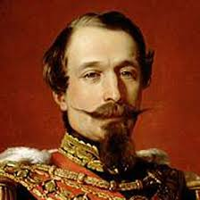
France After the Restoration
Louis Napoleon, nephew of Napoleon Bonaparte
Elected the new President of France in 1848.
Presented himself as a man of the people.
By 1852, proclaimed himself emperor

Slide 31
France After the Restoration
Louis Napoleon took the name Napoleon III
Was given approval to become emperor by a vote of over 90%
His rule would eventually end French power in Europe. (wait a few chapters…)

Slide 32
“Europe Catches Cold”
Between 1830 and 1848, other European ethnic groups launched their own uprisings against conservative rulers.
Rulers became frightened at the prospect of losing power, eventually began to accept reforms.

Slide 33
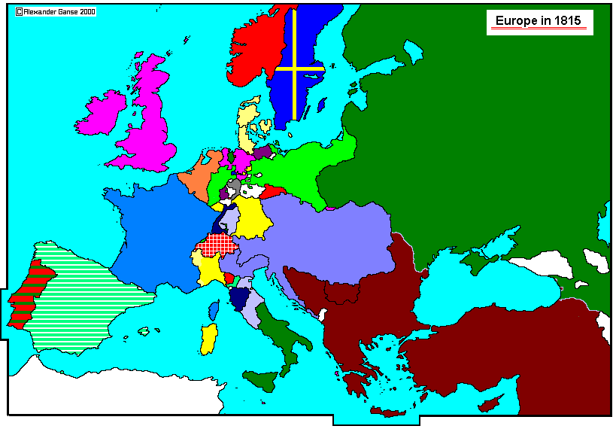
“Europe Catches Cold”

Slide 34
“Europe Catches Cold”
Belgium
The Belgians were upset that the Congress of Vienna had placed them under the rule of the Dutch King.
The Belgians and the Dutch had many differences; religion, language, customs, and economic
Students and workers in Belgium began revolting after hearing of the French uprising against Charles X
In 1831, with British and French support, Belgium became independent, and the other European powers signed an agreement making it a “perpetually neutral”

Slide 35
“Europe Catches Cold”
Poland
Most of Poland was given to Russia during the Congress of Vienna
The Polish resented this and, inspired by France, they revolted against Russia.
The Russians brutally suppressed the revolt.
Survivors fled to western Europe and the United States

Slide 36
The Springtime of the Peoples
“It seemed that the entire world was turned upside down. The improbable became commonplace, the impossible possible…If someone had said, ‘God has been driven from Heaven and a republic has been proclaimed there’…no one would have been surprised.”-Michael Bakunin

Slide 37
The Springtime of the Peoples
Sources of discontent
Middle class liberals wanted more political power
Workers demanded relief from the pain caused by industrialization
Nationalists everywhere worked to overthrow foreign rule

Slide 38
The Springtime of the Peoples
Metternich Falls
In Austria, students and workers revolted against the conservative rule of Clemens Von Metternich
When the influential Metternich, fearing for his life, fled Austria, revolution spread throughout the Empire.
Hungarians led by Louis Kossuth demanded self rule.
In Prague, the Czechs revolted
The Russians army helped the Austrians put down the revolution, executing of exiling those responsible.

Slide 39
The Springtime of the Peoples
Revolution in Italy
Italy was made up of several independent states dominated by the Austrians
Workers and peasants throughout Italy revolted.
French and Austrian soldiers stopped the rebellion, but only for a time. (Chapter 6)

Slide 40
The Springtime of the Peoples
Turmoil in the German States
Students, workers, and women all protested for more political rights.
In Prussia, King Frederick William IV agreed to a written constitution and a legislative assembly, which he dissolved within a year.

Slide 41
The Springtime of the Peoples
Frankfurt Assembly
In 1848, delegates from the many different German states met in an attempt to draft a constitution and unite all of Germany into one.
There were many divisions and disagreements
Finally, all delegates agreed to unite under the Prussian King Frederick William IV, but he turned down the crown.
The King would not take the crown since it was offered from peasants.
The Prussian military threatened the assembly, and it dissolved.

Slide 42
Looking Ahead
Why did many of the revolutions fail?
Lack of mass support
In years to come, Italy and Germany would unify, and many of the liberal reforms would eventually be adopted in Europe….

Slide 43
Make Sure You Can Answer…
Why did revolts break out in France in 1830 and 1848?
How did revolutions in France affect other parts of Europe?
Why did the revolts of 1830 and 1848 generally fail to achieve their goals?

Slide 44
Make Sure You Can Define…
Charter of French liberties
Charles X
Louis Phillipe
Louis Napoleon
Louis Kossuth
Frankfurt Assembly

Slide 45
Latin American War of Independence
“I swear before God and by my honor never to allow my hands to be idle nor my soul to rest until I have broken the chains that bind us to Spain- Simon Bolivar

Slide 46
Make Sure You Can Answer…
What were the long term causes of the revolutions in Latin America?
How did Haiti’s struggle for freedom differ from independence fights in other parts of Latin America?
How did Mexico and the nations of South America win independence?

Slide 47
Make Sure You Can Define…
Toussaint L’Overture
Miguel Hidalgo
El Grito de Dolores
Jose Morelos
Agustin de Iturbide
Tupac Amaru
Simon Bolivar
Jose de San Martin
Dom Perdro

Slide 48
Climate of Discontent
The discontent in Latin America was rooted in the social, racial, and political system from 300 years of Spanish rule.

Slide 49
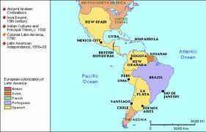
Climate of Discontent

Slide 50
Climate of Discontent
Ethnic and Social Hierarchy
Peninsulares: Those who were born in Spain; held the top jobs in government and the church.
Creoles: Europeans who were born in Latin America
Mestizos: A person of mixed European and
American heritage.
Mulatto: A person of mixed European and African heritage

Slide 51
Climate of Discontent
Enlightenment Ideas
As educated Creoles read the works of Voltaire, Rousseau, and Locke they began to adopt enlightenment ideas.
Translations of the Declaration of Independence were read throughout Latin America
Women hosted and attended Salons called tertulias

Slide 52
Climate of Discontent
Napoleon
When France invaded Spain in 1808 and replaced the Spanish king, Latin American revolutionaries saw an opportunity for independence.

Slide 53
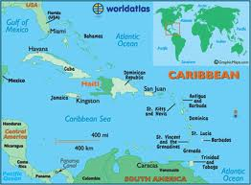
Haiti’s Struggle

Slide 54
Haiti’s Struggle
French plantation owners owned about 500,000 enslaved Africans in Haiti.
The slaves worked producing sugar, but worked under horrible conditions

Slide 55
Toussaint L’Ouverture
The uprising begins
Toussaint used his intelligence and military skills to lead the army of slaves revolting against their many enemies, such as…
Mulattoes, who were promised money to help the French
Spanish soldiers
British soldiers
French soldiers

Slide 56
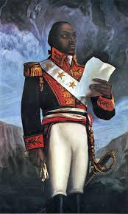
Toussaint L’Ouverture
Born a slave in Haiti
Taught to read by his father
Inspired to Free the slaves of Haiti

Slide 57
Toussaint L’Ouverture
An inspiring commander
“Do not disappoint me, prove yourselves men who know how to value liberty and how to defend it…We are fighting so that liberty-the most precious of all earthly possessions-may not perish. We are fighting to preserve it for ourselves, for our children, for our brothers, for our fellow citizens.”

Slide 58
Toussaint L’Ouverture
Rebuilding
By 1798 Toussaint had won control of most of Haiti, although the island remained a French colony.
French planters began to support Toussaint
Agriculture and trade were improved
Toussaint attempted to write a constitution

Slide 59
Toussaint L’Ouverture
Renewed struggle
When Napoleon Bonaparte took over France, he sent an army to Haiti to take control back from Toussaint.
The Haitian army fought a guerilla war, and a fever spread among the French soldiers, resulting in Napoleon negotiating a truce

Slide 60
Toussaint L’Ouverture
“The tree of black liberty”
After the truce was signed, the French tricked Toussaint and captured him.
After ten months in a French jail, Toussaint died.
In 1804, Haiti declared independence from France, and by 1820 Haiti was the only non-slave nation in the Western hemisphere

Slide 61
Call to Freedom in Mexico
Throughout Spanish America, nobles were frightened by the revolt in Haiti
Nobles wanted power for themselves , and did not want social or economic changes to alter their way of life.

Slide 62
Call to Freedom in Mexico
El Grito de Dolores
“My children will you be free? Will you make the effort to recover the lands stolen from your forefathers by the hated Spanish 300 years ago?”
Father Miguel Hidalgo’s speech inspired many people to join him
In 1810, he marched an army made up of poor mestizos and Native Americans to Mexico City
After some early success, Father Hidalgo was defeated, captured, and executed.

Slide 63
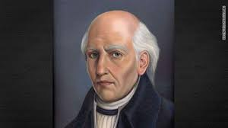
Call to Freedom in Mexico
Miguel Hidalgo

Slide 64
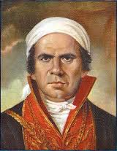
Call to Freedom in Mexico
Jose Morelos
Father Morelos was a mestizo who called for wide ranging reform.
Morelos led a guerilla army opposing Spanish rule, until he too was captured and killed

Slide 65
Call to Freedom in Mexico
Independence Achieved
In 1820, Spanish liberals forced the Spanish king to accept a constitution
Agustin de Iturbide, a conservative creole in Mexico, was afraid liberal reforms would come to Mexico.
In 1821, Iturbide led a revolt and overthrew Spanish rule.
Iturbide then named himself Emperor, and the people overthrew him.
Mexico was free of Spanish rule, but the people would struggle for many years.

Slide 66
Revolutions in South America
As early ad the 1700s, Native Americans had rebelled against the Spanish.
Rebellions became widespread in the 1800s, as several different leaders led armies to battle.

Slide 67
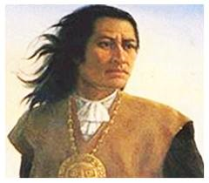
Revolutions in South America
An early challenge
Tupac Amaru claimed to be descended from the Incan royal family.
He demanded that Spain end their brutal system of forced Indian labor
His revolt was crushed in 1780, but Spain eventually abolished the system of forced labor.

Slide 68
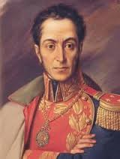
Revolutions in South America
A long Struggle
In 1810 Simon Bolivar led an uprising in Venezuela.
After establishing a republic, Bolivar was toppled by conservative forces
After being imprisoned in Haiti, Bolivar led an army and successfully attacked the Spanish in Colombia.
Bolivar became known as “the liberator”

Slide 69
Revolutions in South America
San Martin
Jose de San Martin was a creole who received military training in Europe.
He led an army to fight the Spanish in Argentina, Chile, and Peru.
San Martin and Bolivar tried to work together, but their differences were too great.
Bolivar became the leader of independence movement.

Slide 70
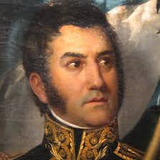
Revolutions in South America
Jose de San Martin

Slide 71
Independence for Brazil
After Napoleon had conquered Portugal, the royal family fled to their colonies in Brazil
Before they returned to Portugal, the King left his son, Dom Pedro, in control of Brazil.
In 1822, following his father’s advice, Dom Pedro led Brazil to independence.
The constitution of Brazil granted freedom of the press, religion, and an elected legislature.

Slide 72
Revolutions in South America
Dreams and Disappointments.
Bolivar tried to unite all of the liberated lands into one country, but was unsuccessful.
The land became three countries; Venezuela, Columbia, and Ecuador.
South American countries never were able to adopt democracy or achieve stable governments in the way Bolivar had hoped.

Slide 73
Make Sure You Can Answer…
What were the long term causes of the revolutions in Latin America?
How did Haiti’s struggle for freedom differ from independence fights in other parts of Latin America?
How did Mexico and the nations of South America win independence?

Slide 74
Make Sure You Can Define…
Toussaint L’Overture
Miguel Hidalgo
El Grito de Dolores
Jose Morelos
Agustin de Iturbide
Tupac Amaru
Simon Bolivar
Jose de San Martin
Dom Perdro

