Slide 1
World War II and Its Aftermath
1931-1949

Slide 2
Chapter Outline
Aggression, Appeasement, and War
The Global Conflict: Axis Advances
The Global Conflict: Allied Successes
Toward Victory
From World War to Cold War

Slide 3
Aggression, Appeasement, and War
Britain, France, and the United States try to avoid war. Germany, Italy, and Japan begin a quest for world domination.

Slide 4
Make Sure You Can Answer…
How did dictators undermine peace in the 1930s?
How was the Spanish Civil War a dress rehearsal for World War II?
Why were western democracies unable to stop aggressive dictators?

Slide 5
Make Sure You Can Define…
Haile Selassie
Rome-Berlin-Tokyo Axis
Guernica
Anschluss
Munich Conference
Neville Chamberlain
Nazi-Soviet Pact
Sanction
Appeasement
pacifism

Slide 6
Early Challenges to World Peace
Japan
Japanese leaders wanted an empire equal to that of Western powers like Great Britain. BY 1937 Japan had conquered much of China, and withdrawn from the League of Nations
Italy
Mussolini defeated an outdated Ethiopian Army to take control of the North African nation. International sanctions had no effect on Italy
Germany
Hitler violated the Versailles treaty by building up his military and seizing land that had been taken after World War One. European leaders pursued a policy of appeasement.

Slide 7
Why Appeasement?
1. France was demoralized due to division within their country
2. Britain thought some of Germany’s actions were justified due to the harsh Versailles Treaty. They also liked Hitler as a buffer to Soviet Communism
3. The U.S. Congress was pursuing neutrality, wanting to avoid getting involved in a conflict, they did not worry about preventing one.

Slide 8
Rome-Berlin-Tokyo
Germany, Italy and Japan allied together. They agreed to
Fight Communism
Not interfere with each others expansionist policies

Slide 9
The Spanish Civil War
Monarchy to Republic
Spain had been a monarchy dominated by the Catholic Church until 1931, when a new republic was set up.
The republic was not that popular as their actions angered those on both the right and left

Slide 10
Nationalists v Loyalists
Francisco Franco led the nationalists, a group of conservatives.
Loyalists were made up of communists, socialists and supporters of democracy
Hitler and Mussolini joined with Franco, The USSR helped the loyalists. France, UK, and USA stayed neutral.

Slide 11
A dress rehearsal
Over one million people were killed in the Spanish Civil War as both sides committed atrocities.
The Nazi air force bombed a small Spanish town called Guernica, which helped the Nazis demonstrate their military power.

Slide 12
German Aggression Continues
Hitler’s goal was to bring all Germanic people under his control.
“Nature is cruel, so we may be cruel too…I have a right to remove millions of an inferior race that breeds like vermin”
-Adolph Hitler, speaking about Slavic countries

Slide 13
Austria Annexed
Hitler was popular in Austria, and had forced the Austrian Chancellor to appoint Nazi’s to key posts.
When the Chancellor did not give into other demands, Hitler sent in the German Army to “preserve order”
The union of Austria and Germany was called the Anschluss
Hitler’s actions violated the Treaty of Versailles

Slide 14
The Czech Crisis
Hitler wanted the land between Czechoslovakia and Germany, called the Sudetenland.
Czechoslovakia was one of two democracies in Eastern Europe, but Britain and France did not want to go to war to defend them.

Slide 15
“Peace for our time”
British Prime Minister Neville Chamberlain, along with the French leader Edouard Daladier, met with Hitler at the Munich Conference in 1938
Britain and France convinced Czechoslovakia to give the Sudetenland to Hitler, who promised no further expansion.

Slide 16
Toward War
In March of 1939 Hitler took over the rest of Czechoslovakia
In August of 1939, Hitler signed a non-aggression pact with the Soviets
In September of 1939, Hitler and the Nazis invaded Poland

Slide 17
Why War Came
Mistakes were made in the creation and enforcement of the Versailles treaty
Western democracies mistakenly chose appeasement to deal with Hitler.
Political and economic problems had focused the attention of nations elsewhere.

Slide 18
Make Sure You Can Answer…
How did dictators undermine peace in the 1930s?
How was the Spanish Civil War a dress rehearsal for World War II?
Why were western democracies unable to stop aggressive dictators?

Slide 19
Make Sure You Can Define…
Haile Selassie
Rome-Berlin-Tokyo Axis
Guernica
Anschluss
Munich Conference
Neville Chamberlain
Nazi-Soviet Pact
Sanction
Appeasement
pacifism

Slide 20
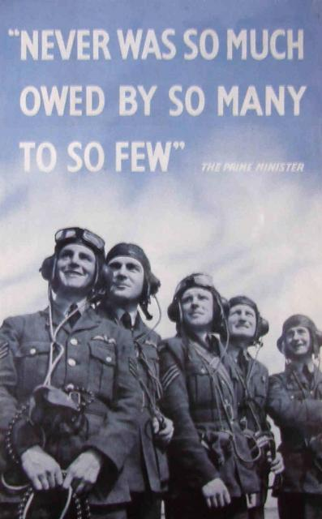
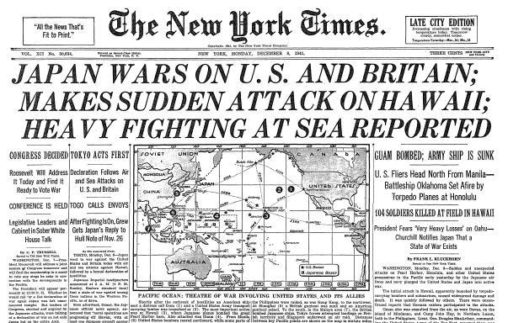
The Global Conflict: Axis Advances

Slide 21
Make Sure You Can Answer…
How did new technologies affect the fighting in World War II?
What goals did the Axis powers pursue in Europe and Asia?
Why did Japan attack the United States?

Slide 22
Make Sure You Can Define…
Phony war
Dunkirk
Winston Churchill
Battle of Britain
Operation Barbarossa
Lend-Lease Act
Atlantic Charter
Pearl Harbor
Blitzkrieg

Slide 23
The First Onslaught
September of 1939 Nazi forces attacked Poland, using a blitzkreig strategy
The USSR attacked Poland from the east, and within a month Poland was no more.
Stalin then took over Estonia, Latvia, Lithuania, and part of Finland.

Slide 24
Early Axis Triumphs
French soldiers, reinforced by the British, stayed behind the Maginot Line, during a time called the Phony War
In April of 1940 Hitler conquerd Norway, Denmark, the Netherlands, and Belgium.

Slide 25
Miracle at Dunkirk
As German forces poured into France, the British and French forces were pushed back, trapped between the advancing army and the ocean.
The British then sent every available ship, both military and civilian, and saved more than 300,000 soldiers by transporting them to Britain.

Slide 26
France Falls
As German forces entered France, Italy declared war and invaded France from the South.
On June 22, 1940, the French government surrendered to Hitler.
The Germans ruled Northern France and set up a puppet government in Southern France called the Vichy government
Charles De Gaulle led the French government in exilie in Britain.

Slide 27
New Technology
Air power and Armored vehicles were used in large numbers for the first time.
Scientists and engineers on both sides improved airplanes and submarines
More deadly bombs were invented, as well as radar and sonar.
Medical advancements helped treat the wounded.

Slide 28
Battle of Britain
The last remaining democracy in Europe was Great Britain. Hitler planned to invade Britain (Operation Sea Lion) but first he wanted to hurt them from the air.
“We shall defend our island, whatever the cost may be” –Winston Churchill

Slide 29
The Battle Begins
August 12, 1940
The German Luftwaffe (air force) began bombing British military targets. They were met by the Royal Air Force.
Since the Luftwaffe could not defeat the RAF, Hitler changed tactics

Slide 30
The London Blitz
On September 7 1940, Hitler began bombing London.
The bombing continued for 57 nights, but the British citizens carried on their daily lives as best they could.
A German Defeat
By June of 1941 Hitler abandoned Operation Sea Lion. The British had persevered, and Hitler then decided to invade the USSR

Slide 31
Charging Ahead
While Hitler was fighting in Britain, Italy was battling the British in Africa. Later the Italians were joined by the Germans commanded by Erwin Rommel.
Italian forces also invaded and conqured Greece and Yugoslavia

Slide 32
Operation Barbarossa
Hitler invaded the Soviet Union because he wanted more land and more natural resources
As the Germans advanced, the Soviets burned towns and crops, eventually the Germans were on the doorstep of Moscow and Leningrad.
Just like Napoleon, Hitler had sent his soldiers into Russia without winter equipment. When Winter came, his advance stalled.

Slide 33
Siege of Leningrad
The 2 and ½ year siege of Leningrad began in September of 1941.
Food was rationed to 2 pieces of bread a day. Starving Soviets then were forced to eat
Paper
Boiled wallpaper
Leather briefcases
Stalin and Churchill then decided to work together

Slide 34
Growing American Involvement
The Arsenal of Democracy
FDR convinced congress to pass the Lend-Lease Act, which allowed him to sell war materials to friendly countries
Roosevelt and Churchill agreed to work together in August of 1941 when they issued the Atlantic Charter

Slide 35
Japan Attacks
As Japan invaded more land in Asia, the US banned the sale of oil to Japan. As the countries met for peace talks, Japan was planning an attack
Pearl Harbor
The Japanese launched a surprise attack on Dec 7, 1941.
The attack severely damaged the U.S. Pacific fleet
The goal of the Japanese was to defeat the U.S. with one mighty attack.
Japanese Victories
Japan then won victories in the Philipines, Hong Kong, and throughout the Pacific

Slide 36
Make Sure You Can Answer…
How did dictators undermine peace in the 1930s?
How was the Spanish Civil War a dress rehearsal for World War II?
Why were western democracies unable to stop aggressive dictators?

Slide 37
Make Sure You Can Define…
Phony war
Dunkirk
Winston Churchill
Battle of Britain
Operation Barbarossa
Lend-Lease Act
Atlantic Charter
Pearl Harbor
Blitzkrieg

Slide 38
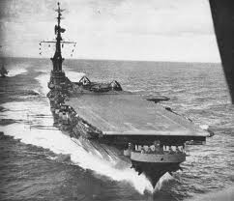
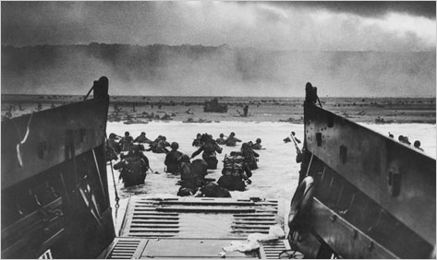
The Global Conflict: Allied Success

Slide 39
Make Sure You Can Answer…
How did the Axis powers treat the people they conquered?
How did Nations mobilize for total war?
What battles were turning points in the war?

Slide 40
Occupied Lands
Nazi Europe
As Hitler took over countries, economic resources were plundered
Art, factories, and other resources were used for Nazi purposes
All races thought to be inferior, such as Slavic people, were used as slave labor

Slide 41
Make Sure You Can Define…
Holocaust
Auschwitz
Greater East Asia Co-Prosperity Sphere
Battle of El-Alamein
Dwight Eisenhower
Battle of Stalingrad
D-Day
collaborator

Slide 42
Nazi Genocide
Hitler built death camps throughout Europe
Nazi officials designed the most efficient way of killing people in the camps
Families were torn apart, as some were killed, others were used for medical experiments, some were forced to work for the Nazi war effort
Some Jewish people tried to resist while in the camps, they were tortured and put to death.

Slide 43
Genocide
Although some people worked to help the persecuted Jews, most turned a blind eye.
Some people were collaborators, helping the Nazis hunt down the Jewish population

Slide 44
The Co-Prosperity Sphere
Japan tried to unite their conquered people under the slogan “Asia for Asians!”
In fact, the Japanese were terrible to the people they conquered.
Civilians were tortured
Crops were burned
Locals were used as slave labor

Slide 45
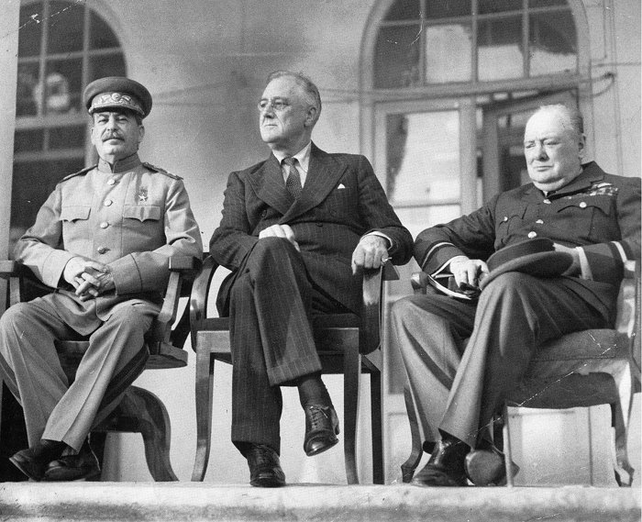
The Allied War Effort
Stalin, Roosevelt, Churchill (known as The Big Three), worked together even though they distrusted each other

Slide 46
Total War
Governments on the Allied side directed industry to produce materials for the war effort
Some governments also limited the rights of citizens
Censored press
Utilized propaganda
Japanese internment

Slide 47
Women and the War
Women took over industrial jobs that had traditionally been held by men
Many women served in the military-not in combat but in a support role such as drivers and analysts
Some women served in combat, such as Lily Litvak in Russia

Slide 48
Turning Points
EL Alamein
British under the command of Gen Montgomery defeated German Gen Rommel
Italy
A combined force of British and American forces invaded Sicily in June of 1943
Italian forces had to be reinforced by Nazi soldiers, which weakened Hitler’s forces elsewhere

Slide 49
The Red Army
Stalingrad
The Germans surrounded the city and a fierce house to house fight ensued
The German commander surrendered in 1943, after 300,000 soldiers were killed, wounded, or captured
Counterattack
The Red Army then went on the offensive, advancing into eastern Europe

Slide 50
Invasion of France
June 6th 1944, D-Day
176,000 Allied soldiers launched an amphibious landing of the France.
After fierce and vicious fighting on the beaches, the Allies broke through.
The French resistance started fighting against the Germans, and Paris was liberated on August 25, 1944

Slide 51
Make Sue You Can Answer…
How did the Axis powers treat the people they conquered?
How did Nations mobilize for total war?
What battles were turning points in the war?

Slide 52
Make Sure You Can Define…
Holocaust
Auschwitz
Greater East Asia Co-Prosperity Sphere
Battle of El-Alamein
Dwight Eisenhower
Battle of Stalingrad
D-Day
collaborator

Slide 53
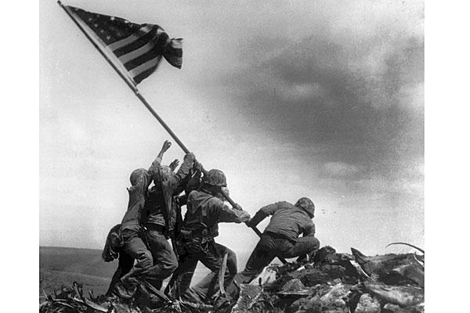
Toward Victory

Slide 54
Make Sure You Can Answer…
What battles were turning points in the Pacific War?
How did the Allied forces defeat Germany?
Why did the United States use the atomic bomb on Japan?

Slide 55
Make Sure You Can Define…
Battle of the Coral Sea
Battle of the Bulge
V-E Day
Harry Truman
kamikaze

Slide 56
War in the Pacific
Six Months after the attack on Pearl Harbor, U.S and Japanese forces fought in the Battle of the Coral Sea and the Battle of Midway
The U.S. was victorious in both battles, and then went on the offensive.
U.S. Gen Douglas MacArthur led the U.S in an “Island Hopping” campaign across the Pacific.
By 1944, American ships were blocking Japan, and the U.S began to retake the Phillipines

Slide 57
The Nazis Defeated
Battle of the Bulge
After France was liberated, the Nazis launched a counterattack. Although it pushed the Allies back, the Germans could not stop their advance
The Air War
By 1945, the Allies had defeated the Luftwaffe and Germany could not defend itself from bombing.
On to Berlin
American and Soviet troops met in Germany, and as they closed in on Berlin Hitler killed himself. In Italy, Mussolini was captured and executed by Italian citizens.
V-E day was declared on May 7, 1945

Slide 58
Defeat of Japan
Invasion v the Bomb
Some estimates said that Americans would suffer 1,000,000 casualties if they invaded Japan.
The Japanese would not surrender, as shown at the battles of Iwo Jima and Okinawa
Scientists had unlocked the secret of Atomic energy, and this offered a alternative to invasion.

Slide 59
Hiroshima
U.S. President Harry Truman gave the order to drop the atomic bomb on August 6, 1945 on the Japanese city of Hiroshima.
The bomb killed 70,000 people instantly
On August 8, 1945 the U.S dropped a second bomb on Nagasaki, killing 40,000 people.
On September 2, 1945 the Japanese formally surrendered on board the U.S.S. Missouri

Slide 60
Make Sure You Can Answer…
What battles were turning points in the Pacific War?
How did the Allied forces defeat Germany?
Why did the United States use the atomic bomb on Japan?

Slide 61
Make Sure You Can Define…
Battle of the Coral Sea
Battle of the Bulge
V-E Day
Harry Truman
kamikaze

Slide 62
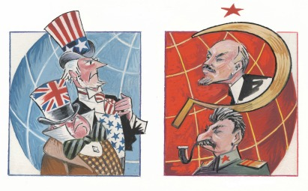
From World War to Cold War

Slide 63
Make Sure You Can Answer…
What were the human and material costs of World War Two?
How did World War Two change the global balance of power?
What were the origins of the Cold War?

Slide 64
Make Sure You Can Define…
UN
Iron Curtain
Truman Doctrine
Berlin airlift
NATO
Warsaw Pact
containment

Slide 65
Aftermath of the War
75 Million Dead Worldwide
38 Million people dead in Europe
22 Million Dead in the Soviet Union

Slide 66
Aftermath of War
Holocaust
Allied nations saw firsthand the horrible abuses suffered by Jewish people
War Crimes
Nazi leaders were put on trial for crimes against humanity, holding people accountable for actions during war
Allied Occupation
The U.S. felt that occupying former Axis powers would help spread democracy and peace.

Slide 67
The United Nations
50 nations joined the assembly
A security council was established to help protect world peace.
As the years went by, the mission of the UN expanded
Preventing disease
Improving education
Helping economic development

Slide 68
The Crumbling Alliance
Growing Differences
Conflicting ideologies and mutual distrust led to problems
Origins
Roosevelt and Churchill wanted free elections throughout the world, Stalin wanted a communist buffer zone between his country and Germany
Iron Curtain
Winston Churchill called the divide between communist east and democratic west the “Iron Curtain”

Slide 69
Containing Communism
Truman Doctrine
President Harry Truman made it the policy of the U.S to keep communism from spreading
Marshall Plan
The U.S. sent billions of dollars in aid to war torn Europe, the USSR would not allow the aid into eastern European countries
Divisions in Germany
Germany was divided into West Germany, a democracy, and East Germany, a communist country.

Slide 70
Containing Communism
Berlin Airlift
In 1948 western democracies air dropped supplies behind the iron curtain into West Berlin
Military Alliances
As tensions grew, the democracies formed NATO while the communist countries formed the Warsaw Pact
The Arms Race
Each side built up both their conventional and nuclear arsenals
Both sides waged a constant propaganda war
The Cold War would last for more than 40 years.

Slide 71
Make sure You Can Answer…
What were the human and material costs of World War Two?
How did World War Two change the global balance of power?
What were the origins of the Cold War?

Slide 72
Make Sure You Can Define…
UN
Iron Curtain
Truman Doctrine
Berlin airlift
NATO
Warsaw Pact
containment

Slide 74
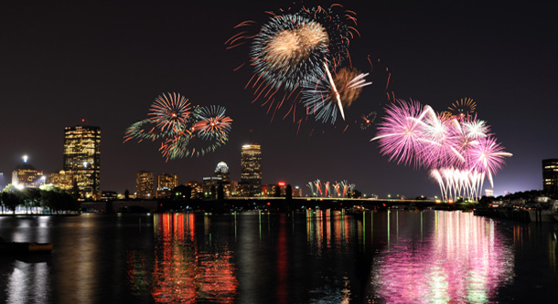
History Class is OVER

