Slide 1
the anglo-saxons
449-1066

Slide 2
The germanic invasions
Britons were conquered by the Romans and became part of the Roman Empire- left unattended and invaded
Many Germanic invaders:
Jutes
Angles
Saxons
Britons fought back, maybe led by King Arthur

Slide 3
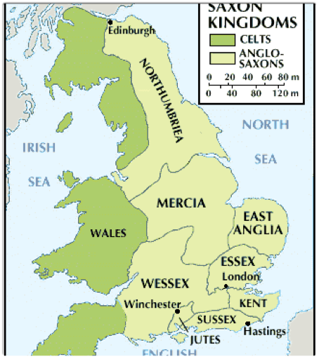
the germanic invasions
Germanic tribes brought a common language- “Old English” or “Anglo-Saxon”
Anglo-Saxon period lasted until around 1066- Battle of Hastings
Norman invasion and conquer- “two kings of England”
England divided into several kingdoms
Kingdoms had to unify to fight of the Danes (Vikings)

Slide 4
anglo-saxon civilization
Anglo-Saxon kingdoms shared common heroic ideals and traditions
”Comitatus”- loyalty between a leader and the tribe
“Wyrd”- Life is short and fate determines where you will end up
Fame and glory were the goals as a result of courage and human will

Slide 5
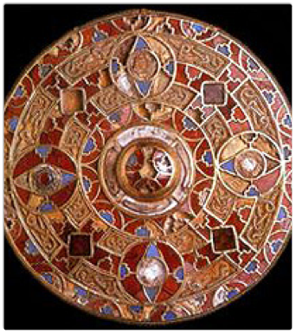
anglo-saxon civilization
Family unit —> clan —> tribe —> kingdom
Democratic - held lots of meetings to talk about what they thought and felt
Held beauty and intelligence in high regard- European rulers went to England to find teachers
Language- weekdays come from Anglo-Saxon gods

Slide 6
the establishment of christianity
Christianity came to Britain early and spread by missionaries from mainland Europe
St. Augustine established a monastery at Canterbury- new religious leaders
Synod (meeting of religious leaders)- united English church with Roman Christianity
Formed “intellectual and commercial" connections between kingdoms and to continental Europe
What comes to Britain along with this new religion?

Slide 7
anglo-saxon literature
Anglo-Saxon poetry is an oral art form- poems not written down until much later
Poems were sung and accompanied by a harp
Professional poet= scop- historian of the tribe
Needed to find ways to remember it- beat and alliteration

Slide 8
Anglo-saxon literature
Two traditions of Anglo-Saxon poetry
Heroic tradition- tells a story of a hero or leader
Elegiac tradition- mourns the passing of better times
Christian beliefs get tacked onto the pagan ones
Riddles were popular
“In media res”- poem begins in the middle of the action

Slide 9
Anglo-saxon literature
The Venerable Bede (673-735)- most famous historian of the time
Alfred the Great- king of England, protected England from Danes
promoted the use of written English
started first historical record in English
made connections with far reaches of the world
formulated a code of law
founded first English public schools

Slide 10
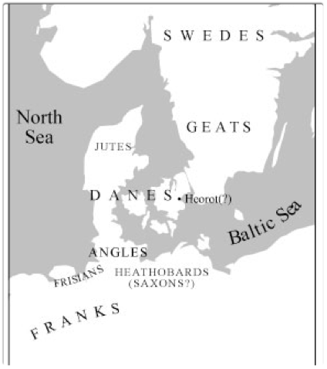
beowulf
Written by an unknown Christian author
Cited as the beginning of English literature
Probably composed some time in the 8th century- only surviving manuscript comes from about 1000
Geats vs. Danes

Slide 11
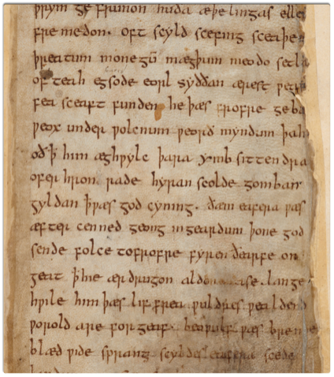
Beowulf
About a hero who becomes a leader of his people
Traditional diction
Translated by Burton Raffel (another translation by Seamus Heaney)
Tone=somber

Slide 12
Literary features of “Beowulf”
Meter
Caesura
Alliteration
Kennings

Slide 13
kennings
Apples are...
TEACHER CANDY

