Slide 1
The French Revolution and Napoleon
1789-1815

Slide 2
On the Eve of the Revolution
What is the Third Estate? Everything!
What has been in the political order up to now? Nothing!
What is it asking for? To Become Something!

Slide 3
Make Sure You Can Answer…
What was the Social Structure of the Old Regime?
Why did France face an economic crisis by 1789?
Why did efforts at reform fail?

Slide 4
Make Sure You Can Define…
Jacques Necker
Cahiers
National Assembly
Bastille
Bourgeoise
Deficit spending

Slide 5
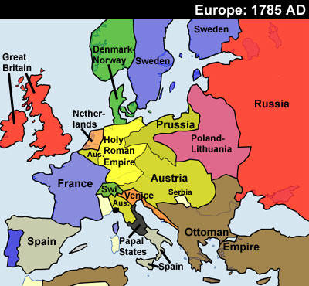
Europe: 1785

Slide 6
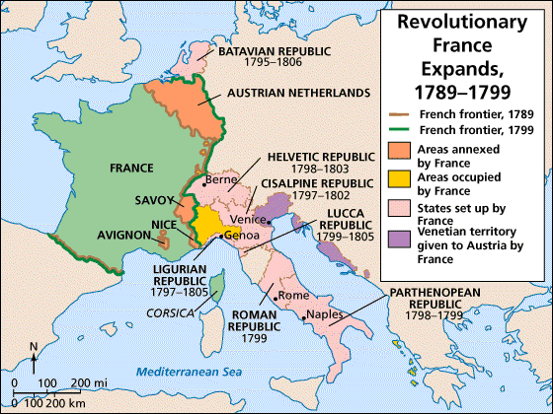
France

Slide 7
The Old Regime
In France in 1789, every person belonged to one of three groups
First Estate: Clergy
Second Estate: Nobles
Third Estate: Everyone Else
This system had emerged in the Middle Ages, and was outdated as Europe embraced the Enlightenment

Slide 8
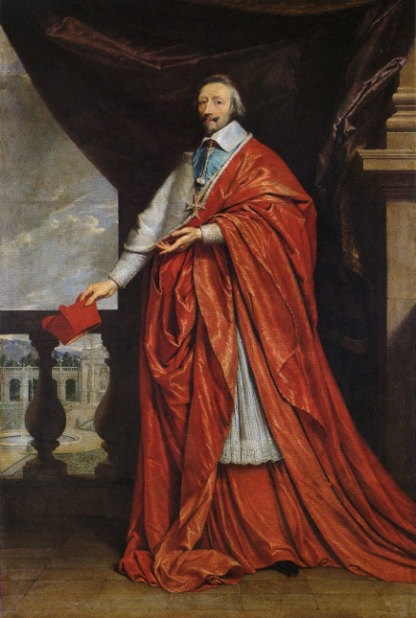
Clergy: The First Estate
Officials of the Catholic Church
Had enormous wealth, but paid no taxes
Provided some social services
Schools, hospitals, orphanages
Enlightenment thinkers did not like the church being involved in politics, or their intolerance of dissent

Slide 9
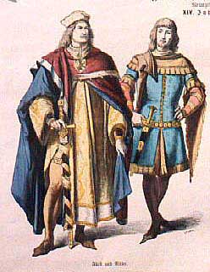
Nobles: The Second Estate
The Nobles had no military power and were under strict Royal control
Nobles were given the best jobs in government and the church, even if they weren’t qualified
Nobles paid no taxes, and were afraid that would change

Slide 10
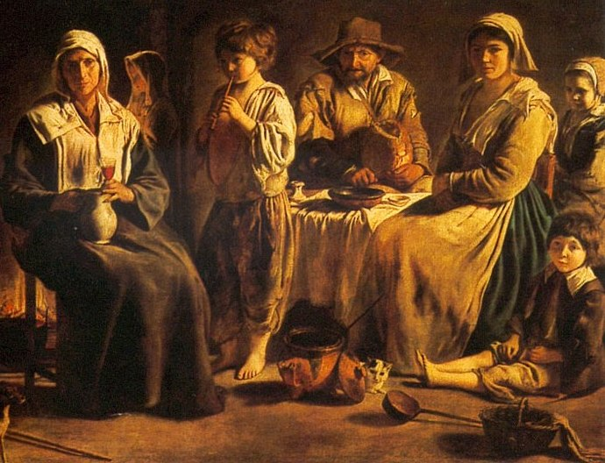
The Third Estate
Made up of 98% of the French population
At the top of the Third Estate were the bourgeoisie.
Most people in the Third Estate were rural peasants
The poorest members were city workers
The Third Estate paid all the taxes, they supported the French government.

Slide 11
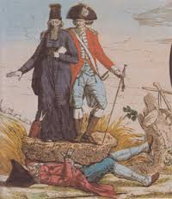
Discontent

Slide 12
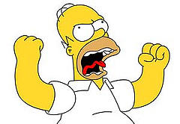
Discontent
Members of the Third Estate resented the system, they felt it was unfair.
Peasants paid taxes on everything.
They were angry when those taxes rose, or new ones were introduced
Only Nobles were allowed to hunt
Many peasants embraced the Enlightenment, and questioned the old order.

Slide 13
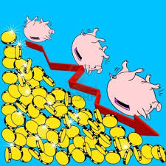
A Financial Crisis
The French government had used deficit spending for years
The King had Spent money on the Seven Years War, and during the American Revolution
The Nobles spent lots of money to finance their lavish lifestyle
The only solution was to increase taxes, reduce expenses, or both

Slide 14
Crumbling Economy
In the 1780s, a bad harvest caused food prices to skyrocket
People started to riot, as they had no food or money to buy food.

Slide 15
Failure of Reform
The King was advised by Jacques Necker, who told him to reduce spending, reform government, and tax the First and Second Estate.
The Nobles and Clergy did not want to pay taxes.
The King Summoned the Estates-General, something that had not happened in 175 years.

Slide 16
Jacques Necker

Slide 17
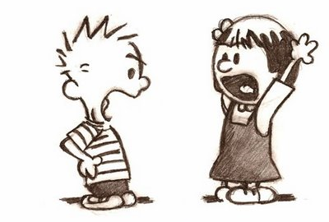
The King Takes Action
In May of 1789, the Estate-General met at Versailles.
The King asked each group to prepare cahiers.
The cahiers showed how each group was angry with the others, and the resentment was evident.

Slide 18
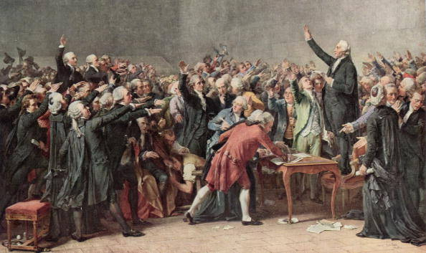
The Tennis Court Oath
The Third Estate had wanted all groups to vote together, but the 1st and 2nd estate did not want this to happen
When the members of the Third Estate were accidentally locked out of the meeting hall, they vowed not to disband their newly formed National Assembly until France had a Constitution.

Slide 19
Storming the Bastille
Rumors were rampant around Paris that Royal troops were coming to take control of the city.
Groups of peasants formed outside the Bastille, and when the commander refused to open the gates the peasants charged in and took over.
“Is it a revolt?” The King asked, “No Sire, ‘tis a revolution”

Slide 20
Make Sure You Can Answer…
What was the Social Structure of the Old Regime?
Why did France face an economic crisis by 1789?
Why did efforts at reform fail?

Slide 21
Make Sure You Can Define…
Jacques Necker
Cahiers
National Assembly
Bastille
Bourgeoisie
Deficit spending

Slide 22
Creating a New France
King→ National Assembly→ Legislative Assembly→ National Convention→ Directory→ Consulate→ Napoleon

Slide 23
Make Sure You Can Answer…
How did popular uprisings contribute to the French Revolution?
What political and social reforms emerged in the early stages of the revolution?
How did people outside France respond to the revolution?

Slide 24
Make Sure You Can Define…
Great Fear
Marquis de Lafayette
Tricolor
Legislative Assembly
Declaration of Pilnitz
Jacobins
Émigré
Sans-culotte

Slide 25
Revolts in Paris and the Provinces
As France faced the political crisis of 1789, they also faced a terrible famine
While the famine was ongoing, Nobles tried to raise taxes on the Third Estate
Rumors were also swirling that government soldiers were taking peasant crops, that was called the Great Fear
In response, peasant’s attacked the homes of nobles

Slide 26
Paris in Arms
The capital city of Paris, France was the revolutionary center
Different groups were competing for power
Many people looked to the moderate Marquis de Lafayette, who led the National Guard, the first to wear the tricolor.
The more radical Paris Commune replaced the royal government of the city.

Slide 27
Liberty, Equality, Fraternity
An End to special privilege
The nobility voted in the National Assembly to give up the special rights the had enjoyed.
This was a step toward all people being treated equally.
Declaration of the Rights of Man
This document was the first step toward a constitution
Based on the American Declaration of Independence and the writings of John Locke
Called for basic freedoms
The King was slow to accept these changes….

Slide 28
Women March on Versailles
King Louis XVI and his wife, the Austrian Marie Antoinette lived at the Palace of Versailles.
http://en.chateauversailles.fr/homepage
Did anyone else in modern times live like that?
http://www.hearstcastle.org/

Slide 29
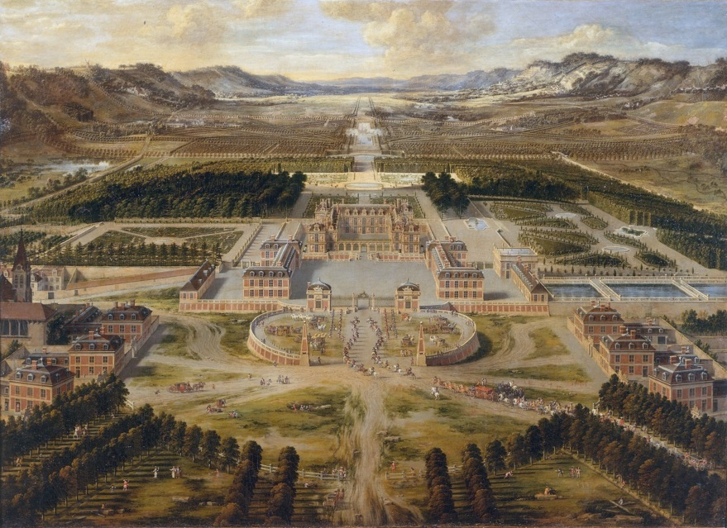
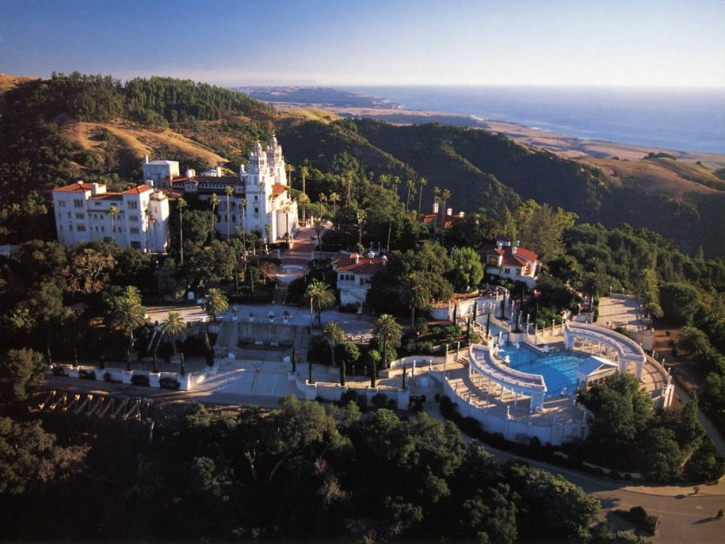
Versailles and Hearst Castle

Slide 30
Women March on Versialles
“We’ll wring her neck!”
People were upset with the life of luxury enjoyed by Marie Antoinette, and they blamed her for many of the country’s problems
“Tear out her heart, cut off her head, fry her liver and even then it won’t be over!”
Lafayette calmed the crowd down, the King agreed to return with the women to Paris

Slide 31
A triumphant procession
The royal family was forced to live in Paris as virtual prisoners.
“You have to be a mother and have heard your children ask for bread you cannot give them to know the level of despair to which this misfortune can bring you.”

Slide 32
A Time of Reform
The Church
The National Assembly voted to take over and sell Church lands
The French Catholic Church came under the control of the government with The Civil Constitution of the Clergy, issued in 1790.
Bishops and Priests were now elected
The Authority of the Pope was ended in France.
Catholics throughout Europe were very angry.

Slide 33
A written Constitution
Set up a limited Monarchy
Gave the Legislative Assembly power to make laws and collect taxes
Protected Private property and supported free trade
Reformed laws

Slide 34
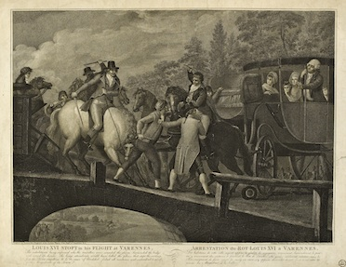
The fateful night
King Louis and Marie Antoinette were scared and tried to escape.
As they tried to leave France they were recognized and caught

Slide 35
Reaction outside France
Widespread Fears
European rulers throughout the continent were angered by stories told to them by emigres
As a result of the treatment of French nobles, many European countries denounced the revolution
Threats from abroad
Prussia and Austria issued the Declaration of Pilnitz.

Slide 36
War at Home and Abroad
Sans-Culottes
Working class French demanded an end to the monarchy and a formation of a republic. They were supported by the Jacobins
From Left to Right
The Legislative assembly contained many factions.
Those who thought the revolution had gone too far sat on the right, the Jacobins sat on the left.
War on tyranny
Groups on the left held the upper hand, and declared war on other European monarchs.

Slide 37
Make Sure You Can Answer…
How did popular uprisings contribute to the French Revolution?
What political and social reforms emerged in the early stages of the revolution?
How did people outside France respond to the revolution?

Slide 38
Make Sure You Can Define…
Great Fear
Marquis de Lafayette
Tricolor
Legislative Assembly
Declaration of Pilnitz
Jacobins
Émigré
Sans-culotte

Slide 39
Radical Days
Radical: thoroughgoing or extreme, especially as regards change from accepted or traditional forms:

Slide 40
Make Sure You Can Answer…
Why did the revolution become more radical?
What was the reign of terror?
How did the French Revolution change daily life?

Slide 41
Make Sure You Can Define…
Committee of Public Safety
Maximillien Robespierre
Directory
Olympe de Gouges
La Marseilles
Jacques Louis David
Suffrage
Nationalism

Slide 42
Downfall of the monarchy
Bloodthirsty savages or patriots?
As the war with Prussia started to go badly, French citizens blamed the King
After his guards were slaughtered, the King sought the protection of the Legislative Assembly
Soon after, nobles and priests who were imprisoned were killed by angry mobs

Slide 43
The French Republic
Radicals took control of Paris and replaced the legislative Assembly with the National Convention
The Convention was more extreme, and voted to extend suffrage, but also to end the monarchy and seize noble lands
All men and women were addressed by the title Citizen.

Slide 44
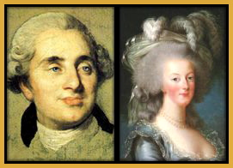
Death of a King and Queen

Slide 45
Death of a King and Queen
As the revolution became more radical, Louis XVI and Marie Antoinette were put on trial and found guilty, they were both sentenced to die.
Shortly after their execution, their son died in prison.

Slide 46
The Convention under siege
1793: France was at war with
Britain
Netherlands
Spain
Prussia
In western France royalists and Priests were leading a rebellion against the new government
The sans-culottes were unhappy with rising food prices

Slide 47
How to deal with the problems?
Committee of Public Safety
A 12 member group given almost absolute power, and tasked with saving the revolution
France developed new tactics in battle and defeated the Netherlands, invade Italy, and crushed revolts within France.

Slide 48
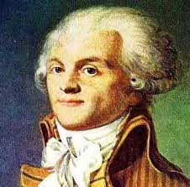
Robespierre
“Liberty cannot be secured unless criminals lose their heads”

Slide 49
Robespierre
Maximilien Robespierre was the leader of the Committee of Public Safety.
Some people called him “the incorruptible” others called him a tyrant.
Robespierre believed in Rousseau’s idea of the general will. He believed in religious toleration and wanted abolish slavery.

Slide 50
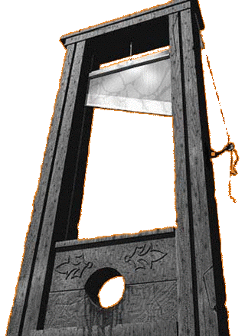
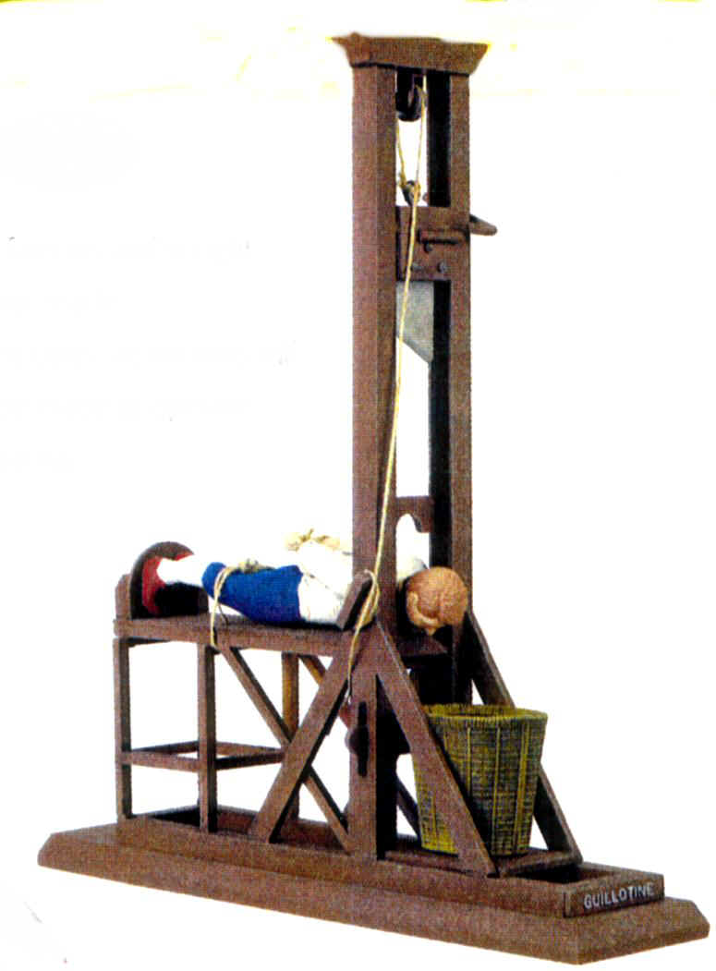
Reign of Terror

Slide 51
Reign of Terror
Robespierre wanted to eliminate anyone who did not support France in the way he wanted them to.
Around 40,000 people were killed during the reign of terror.
15% were Nobles and Clergy
15% were middle class citizens, moderates who had supported the revolution
70% were peasants. Some were cases of mistaken identity, some were victims of false accusations

Slide 52
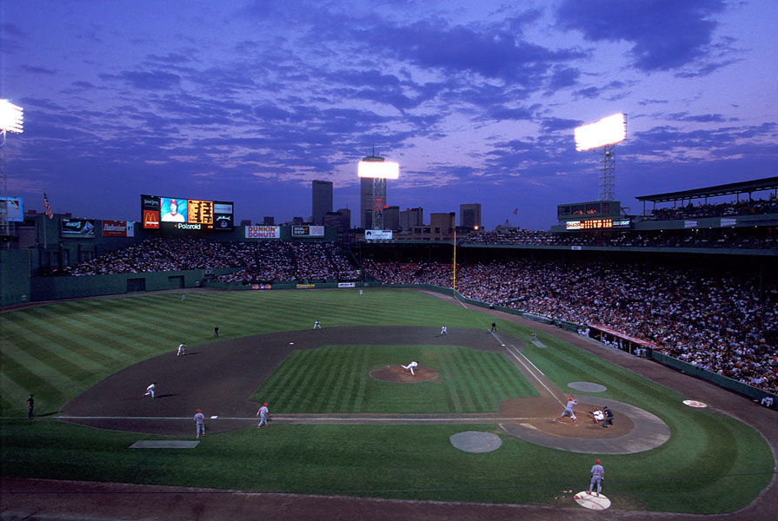
How many is 40,000?
Fenway park holds 37,400 people…
So everyone inside Fenway…PLUS 2,600 MORE!
#Horrible!
#toomany
#amidoingthisright?

Slide 53
Reaction and The Directory
Eventually people grew tired of Robespierre, and he was executed, along with other radicals
France then wrote another new Constitution, and set up the Directory, another new government
As the Directory proved to be weak and ineffective, France would soon turn to yet another new government

Slide 54
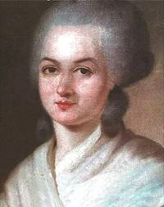
Women in the Revolution
Rights
Women were not named in the Declaration of the Rights of Man, disappointing many including Olympe de Gouges who wrote Declaration of the Rights of Women
Women were given the right to inherit property, and divorce was made easier

Slide 55
Women in the Revolution
Setbacks
Women were not granted equal status with men
Women did not have the right to express their views in public
Women did not have “the moral and physical strength necessary to practice political rights.”

Slide 56
Changes in Daily Life
Nationalism
People in France had a strong sense of National Identity
La Marseillaise:
Arise children of the fatherland
The day of glory has arrived
Against us tyranny's
Bloody standard is raised
Listen to the sound in the fields
The howling of these fearsome soldiers
They are coming into our midst
To cut the throats of your sons and consorts

Slide 57
Social Reform
Compulsory elementary education, state schools replaced religious ones.
The government organized care for the elderly, poor, and soldiers
Slavery was abolished, religious toleration was increased
Arts
French art moved toward a classical style
Jacques Louis David painted scenes from the Tennis Court Oath and others

Slide 58
Make Sure You Can Answer…
Why did the revolution become more radical?
What was the reign of terror?
How did the French Revolution change daily life?

Slide 59
Make Sure You Can Define…
Committee of Public Safety
Maximillien Robespierre
Directory
Olympe de Gouges
La Marseilles
Jacques Louis David
Suffrage
Nationalism

Slide 60
The Age of Napoleon Begins
“He was like an expert chess player, with the Human race for an opponent, which he proposed to checkmate”

Slide 61
Make Sure You Can Answer…
How did Napoleon gain power?
What role did Napoleon play in furthering the French Revolution?
How did Napoleon build and defend his empire?

Slide 62
Make Sure You Can Define…
Consulate
Concordat of 1801
Napoleonic Code
Battle of Trafalgar
Confederation of the Rhine
Continental System
Plebiscite
Annex
blockade

Slide 63
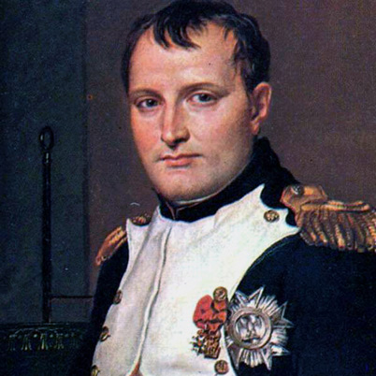
Napoleon

Slide 64
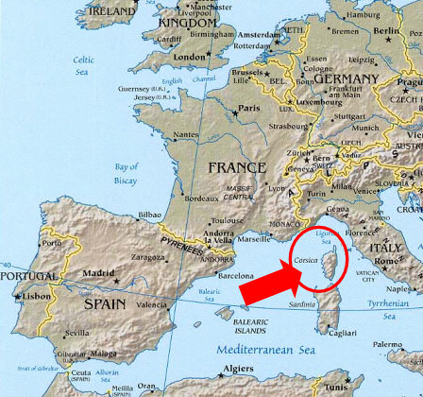
The Man From Corsica
Napoleon Bonaparte was born on the French Island of Corsica, in the Mediterranean Sea

Slide 65
The Man From Corsica
Napoleon’s parents were minor nobles with little money.
Napoleon was sent to France at age nine to be trained for a military career.
When the revolution broke out, Napoleon wanted to make a name for himself
Napoleon favored the Jacobins, but believed…

Slide 66
The Man from Corsica
“Since one must take sides, one might as well chose the side that is victorious, the side which devastates loots and burns. Considering the alternative, it is better to eat than be eaten”
What does Napoleon believe is the best side to support?

Slide 67
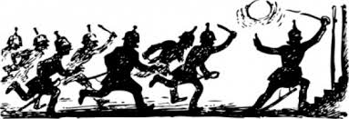
The Man from Corsica
Early Success
Napoleon served in the French Army during the revolution, winning impressive victories against the British and Austrians
Even when he lost, like when he fought in Egypt, Napoleon hid the stories of his defeats.

Slide 68
The Man From Corsica
1799: The popular Napoleon helped overthrow the Directory and set up the Consulate
After another constitution was written, Napoleon took the title First Consul, and then Consul for life.

Slide 69
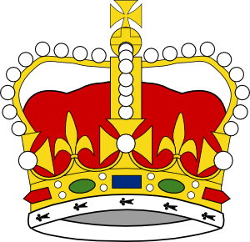
A self made emperor
Napoleon then proclaimed himself Emperor of France.
He invited the Pope to his coronation.
When the Pope was about to put the crown on his head, Napoleon took the crown and said “I crown myself”
At each step on his rise to power Napoleon held a plebiscite, which showed the popular support of his authority.

Slide 70
Reforms
Napoleon regulated the economy by…
Controlling prices
Building roads and canals
A system of public schools
Encouraged new industry

Slide 71
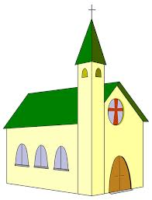
Peace with the Catholic Church
Napoleon made peace with the Catholic Church with The Concordat of 1801
Kept the Church under state control
Recognized religious freedom of Catholics

Slide 72
Broad Support
People from different classes all supported Napoleon
Peasants: Land rights were recognized
Emigres: Napoleon told them they could return to France, so long as they took a loyalty oath
Middle Class: Liked the economic reforms and return of order

Slide 73
Change in the Law
New laws were put in place under Napoleon, called the Napoleonic Code
The law was popular because it embraced Enlightenment principles, advancement based on merit, and religious toleration
The law undid some reforms, limiting women’s rights.

Slide 74
Subduing an Empire
“I grew up on the field of battle, and a man such as I cares little for the lives of a million men.” -Napoleon

Slide 75
The Grand Empire
Napoleon’s military conquests redrew the map of Europe.
Annexed the Netherlands and Belgium, parts of Italy and Germany
Abolished the Holy Roman Empire, replacing it with the French dominated Confederation of the Rhine
Took over part of Prussia
Forced Russia, Spain, Austria, and Prussia to sign treaties
Made his brother King of Spain.
Napoleon divorced his wife and married Marie Antoinette’s niece.

Slide 76
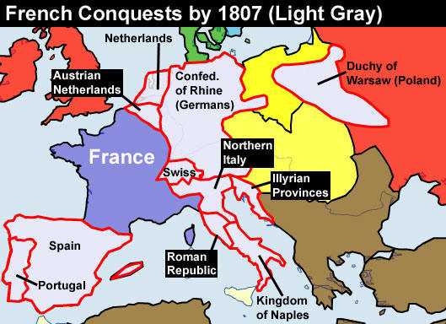
Napoleon’s Conquest

Slide 77
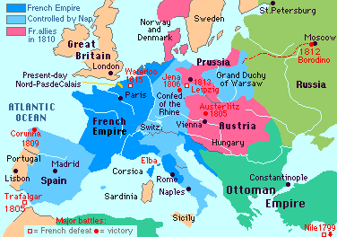
Napoleon’s Conquest

Slide 78
France v Britain
The United Kingdom was the only European power left to oppose Napoleon
In 1805 the French Navy fought against the British off the southwest coast of Spain in the Battle of Trafalgar

Slide 79
After the Battle
France then decided to try and defeat Britain economically by using the Continental System
Britain responded with its own blockade

Slide 80
Success and Failures
The Continental system did not force Britain to surrender, instead it caused prices on goods in Europe to increase.
Many Europeans were resentful of France and began smuggling.
The age of Napoleon was a source of pride for the French.

Slide 81
Make Sure You Can Answer…
How did Napoleon gain power?
What role did Napoleon play in furthering the French Revolution?
How did Napoleon build and defend his empire?

Slide 82
Make Sure You Can Define…
Consulate
Concordat of 1801
Napoleonic Code
Battle of Trafalgar
Confederation of the Rhine
Continental System
Plebiscite
Annex
blockade

Slide 83
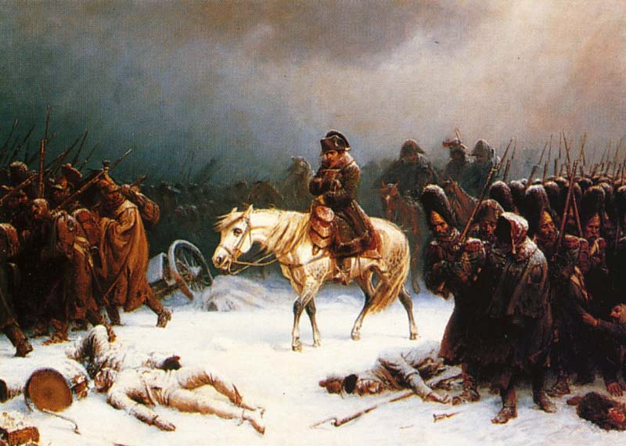
The End of an Era

Slide 84
Make Sure You Can Answer…
What events led to Napoleon’s downfall?
What principles guided leaders at the Congress of Vienna?
How did the Congress of Vienna seek to impose a new order on Europe?

Slide 85
Make Sure You Can Define…
Waterloo
Clemens Von Metternich
Concert of Europe
Guerrilla Warfare
Abdicate
Legitimacy

Slide 86
Challenges to Napoleon’s Empire
As Napoleon’s armies spread across Europe, they spread the ideas of the Enlightenment.
As these ideas spread, people began to resent Napoleon for a few reasons…
1. The French were seen as foreign oppressors
2. Europeans resented the Continental System
3. People were upset at the attempt to impose French culture

Slide 87
Resistance in Spain
Napoleon had made his brother King of Spain, and had tried to undermine the Spanish Catholic Church
The Spanish resented these changes, as well as the brutal responses of the French
The Spanish began fighting against the larger, better armed French Army using guerilla warfare.

Slide 88
Defeat in Russia
Napoleon sent 600,000 soldiers to invade Russia after Czar Alexander I withdrew from the continental system.
As the French army invaded, the Russian army would burn towns, crops, and anything else that might support the French.
By the time Napoleon’s army approached Moscow, their supplies were gone and winter was coming.

Slide 89
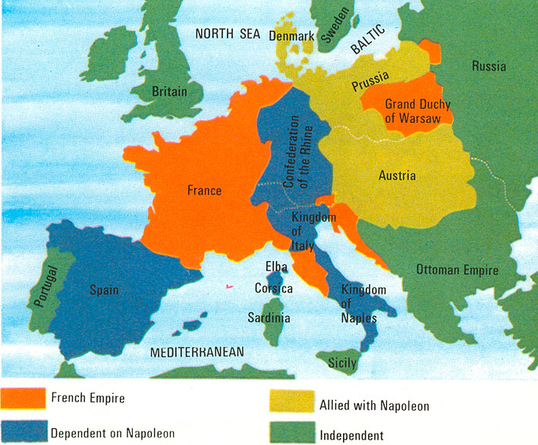
Defeat in Russia

Slide 90
Defeat in Russia
In October of 1812, Napoleon started to retreat from Russia
As he marched toward France, Napoleon lost most of his soldiers.
“The army marched covered in great snowflakes, The straggles fall to the lances of the Cossacks. As for me, I cover the retreat. Behind me flies the army with broken ranks. It is a mob without purpose, famished, feverish…General Famine and General Winter, rather than Russian bullets have conquered the Grand Army. “

Slide 91
Downfall of Napoleon
Russia, Britain, Austria, and Prussia defeated the French army at the Battle of the Nations in 1813.
After the defeat, Napoleon abdicated, and lived in exile on Elba, and Island in the Mediterranean Sea.
Louis XVIII, brother of the former King, became King of France.

Slide 92
Napoleon Returns
When the new King found it difficult to lead France, Napoleon escaped is exile and returned.
Napoleon’s second rule lasted only 100 days, when he was defeated in the Battle of Waterloo.
Following the battle, Napoleon returned to exile, where he died in 1821.

Slide 93
Napoleon’s Legacy
The Napoleonic Code lasted for many years.
Suffrage in France was expanded.
Property rights had been expanded
Throughout Europe, Nationalistic feelings stirred by Napoleon swept across Europe.

Slide 94
Congress of Vienna
Diplomats from across Europe gathered in Austria to restore stability after 25 years of war.
The diplomats wanted to create a lasting peace by establishing a balance of power and a system of monarchy.

Slide 95
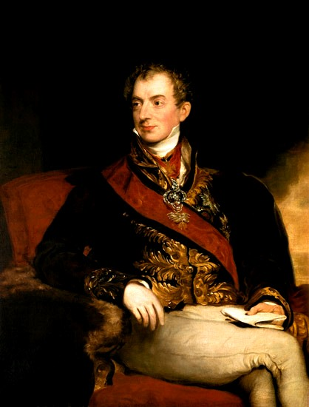
Clemens Von Metternich
Austrian
Wanted to restore status quo
Most influential

Slide 96
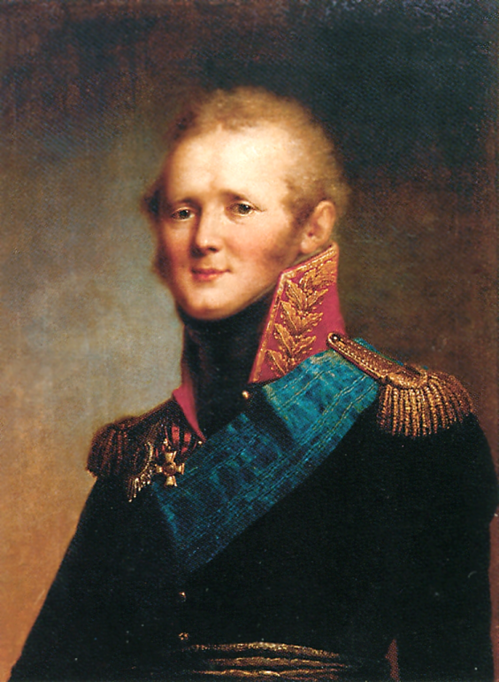
Czar Alexander I
Russian
Proposed a “holy alliance”
Wanted Christian nations to work together.

Slide 97
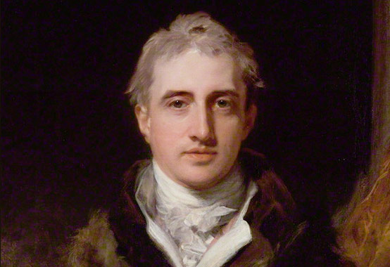
Lord Robert Castlereagh
British
Wanted to prevent the French from having a powerful military.

Slide 98
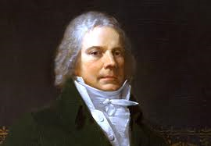
Prince Maurice Talleyrand
French
Very politically savvy.
Played other leaders against each other

Slide 99
The Vienna Settlement
Balance of Power
Borders were redrawn to surround France with powerful neighbors.
Stability
The settlement promoted legitimacy
Metternich pushed to create the Concert of Europe
Leaders pledged to maintain the balance of power
Leaders pledged to suppress any uprisings similar to the French revolution

Slide 100
The Vienna Settlement
Problems
Borders were redrawn without regard to cultures
Germans were put under Austrian rule, but leaders failed to see how Germans would want to unite into one country.
Looking ahead
The peace that was established lasted, but it was not permanent.
The Ideals of the French revolution inspired people throughout the world to seek freedom.

Slide 101
Make Sure You Can Answer…
What events led to Napoleon’s downfall?
What principles guided leaders at the Congress of Vienna?
How did the Congress of Vienna seek to impose a new order on Europe?

Slide 102
Make Sure You Can Define…
Waterloo
Clemens Von Metternich
Concert of Europe
Guerrilla Warfare
Abdicate
Legitimacy

