Slide 1
World War One and Its Aftermath
1914-1919

Slide 2
Section Outline
The Stage is Set
The Guns of August
A New Kind of Conflict
Winning the War
Making the Peace

Slide 3
The Stage is Set
Why did so many people in the early 1900s believe that war was unlikely
What forces pushed Europe toward war?
What were the causes and effects of European Alliances?

Slide 4
Vocabulary
Alfred Nobel
Pan-Slavism
Central Powers
Allies
Militarism

Slide 5
Peace?
Strong efforts to end war
Citizen efforts
Alfred Nobel
Women’s International League for Peace and Freedom
Government efforts
First Universal Peace Conference
Hague Tribunal

Slide 6
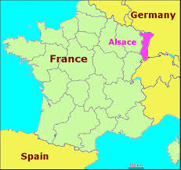
Aggressive Nationalism
Alsace and Lorraine
Germany was proud of their military might, France wanted to regain lost power
Pan-Slavism
All Slavic people have a common ancestry, Russia felt a duty to lead and defend all Slavic people, notably Serbia

Slide 7
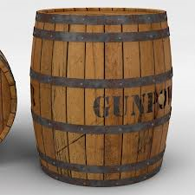
Balkan Crisis
Austria-Hungary and The Ottoman Empire were very worried about the Balkans
Serbia was being very aggressive.
Serbia wanted to create and lead a united Slavic country
Several wars led to the Balkans being the “powder keg of Europe”

Slide 8
Economic and Imperial Rivalries
Britain was threatened by Germany’s economic growth.
Germany felt they deserved more respect than they were getting
1905 and 1911
Germany wanted to keep France from making Morocco a protectorate. Germany gained territory, and tensions increased

Slide 9
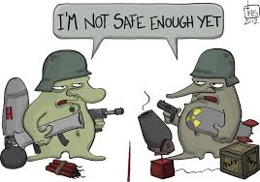
Militarism and the Arms race
Militarism grew out of Social Darwinism.
Great powers competed to build a bigger Army and Navy.
Should nations keep a large weapons stockpile?

Slide 10
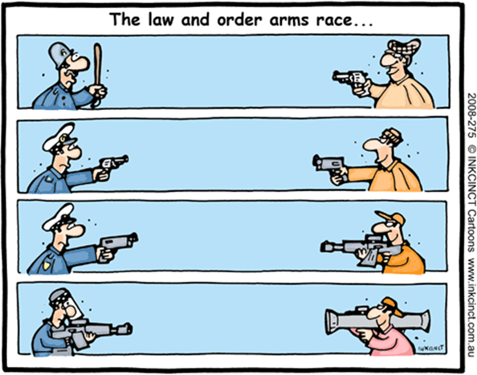
Militarism and the Arms race
“We must build a bigger navy than the enemy will build when he hears we're building a bigger navy than he’s building”

Slide 11
A Tangle of Alliances
Central Powers
Bismarck had signed treaties with countries to prevent attacks from France
Germany was part of the Triple Alliance along with Austria-Hungary and Italy
The Allies
France, Russia, Britain
Other countries were drawn in as Germany signed a treaty with the Ottomans, and Britain with the Japanese

Slide 12
Can you Answer?
Why did so many people in the early 1900s believe that war was unlikely
What forces pushed Europe toward war?
What were the causes and effects of European Alliances?

Slide 13
Can You Define?
Alfred Nobel
Pan-Slavism
Central Powers
Allies
Militarism

Slide 14
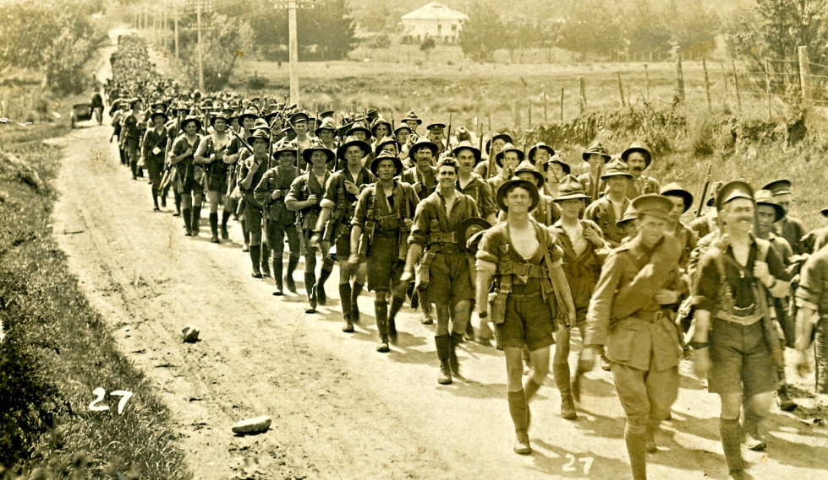
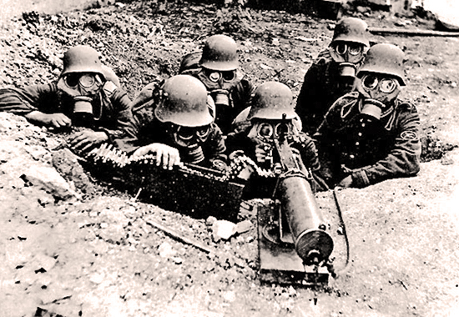
The Guns of August

Slide 15
Make Sure You Can Answer
How did ethnic tensions in the Balkans spark a political assassination?
How did Conflict between Austria-Hungary and Serbia widen?
Whom do historians blame for the outbreak of World War I?

Slide 16
Make Sure You Can Define
Francis Ferdinand
Gavrilo Princip
Black Hand
Schlieffen Plan
Ultimatum
Mobilize
Neutrality

Slide 17
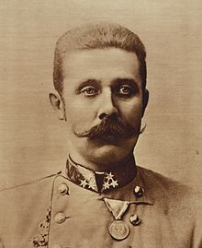
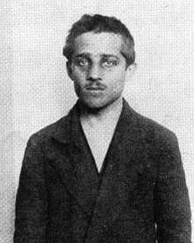
One Murder, Million of Victims
Francis Ferdinand Gavrilo Princip

Slide 18
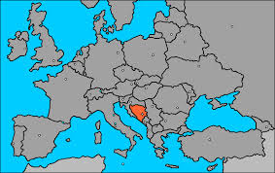
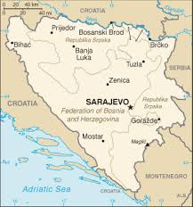
One Murder, Million of Victims
Archduke Ferdinand of Austria-Hungary was visiting Sarajevo (Capital of Bosnia) on June 28th, the same anniversary of Bosnia being conquered by the Ottomans

Slide 19
The Killer
Gavrilo was 19, his family was poor, he had grown up under Austrian Rule
He joined a group called The Black Hand, whose goal was to organize all Southern Slavic People into a single nation.

Slide 20
The Victims
Archduke Francis Ferdinand and his wife, Countess Sophie
Sophie had been snubbed by Francis’ Family, since she was from a low social rank
Francis was not a supporter of democracy, but he had talked of making concessions to the Slavs when he became emperor.
His talk made enemies both inside and outside of Austria

Slide 21
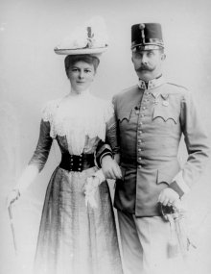
Mama and I are very well…
“We gave a large dinner party yesterday and this morning there is a big reception is Sarajevo. Another large dinner party after that and then we are leaving, Dearest Love to you all…

Slide 22
The Murder
The Archduke’s motorcade was attacked by The Black Hand, injuring a guard
The Archduke continued with his plans after that, but asked to visit the guard in the hospital
The driver did not hear the request and continued on the normal route. When he stopped to put the car in reverse, Gavrilo fired.
“Sophie!, Sophie don’t die! Stay alive for the children!”

Slide 23
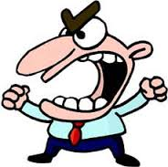
The Punishment
Gavrilo was caught, but since he was under 20, he could not be put to death
The lack of death penalty outraged the Austro-Hungarians

Slide 24
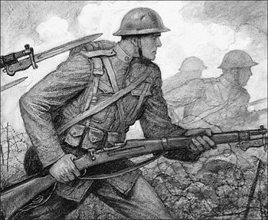
Peace Unravels
Harsh Ultimatum
Francis Joseph demanded Serbia punish all Serbian official involved in the plot, end all Anti-Austrian activity, and allow Austria to take part in the investigation.
Serbia agreed to some, but not all of the demands
Austria declared war on July 28th

Slide 25
Peace Unravels
Capital to Capital
Germany had advised Austria to go to war. Kaiser William II (remember him?) was horrified that a member of a Royal family had been killed
Nicholas II (remember him?) failed to convince the Kaiser to convince Austria to back down, then Russia started to mobilize.
France was eager to avenge the Franco-Prussian war, and told Russia they would back them in a war with Germany
At this point, Italy and Britain remained Neutral

Slide 26
Schlieffen Plan
Germany wanted to avoid a two front war, fighting France on the western front and Russia on the eastern front.
The plan called for Germany to defeat France quickly and then focus on Russia
Germany had to attack France through Belgium, which brought Britain into the war.

Slide 27
Schlieffen Plan

Slide 28
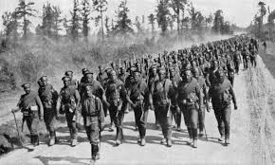
Whose Fault?
Everyone
Each nation involved had reasons for fighting that, in their mind, were good and just reasons.
“The lamps are going out all over Europe. We shall not see them again in our lifetime”

Slide 29
Make Sure You Can Answer
How did ethnic tensions in the Balkans spark a political assassination?
How did Conflict between Austria-Hungary and Serbia widen?
Whom do historians blame for the outbreak of World War I?

Slide 30
Make Sure You Can Define
Francis Ferdinand
Gavrilo Princip
Black Hand
Schlieffen Plan
Ultimatum
Mobilize
Neutrality

Slide 31
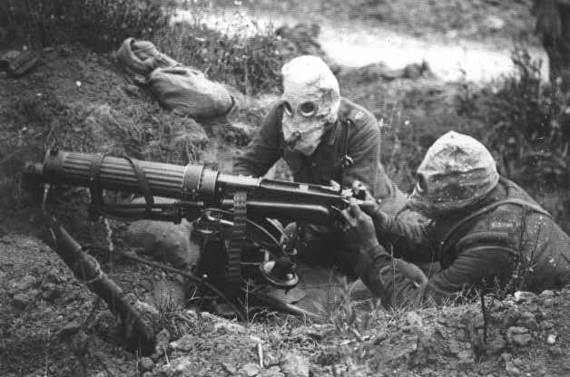
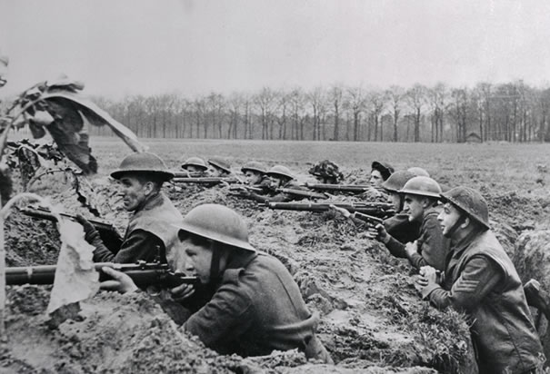
A New Kind of Conflict
“One out of every Four men who went out to the World War did not come back again, and of those who came back, many are maimed and blind and some are mad.”

Slide 32
Make Sure You Can Answer
Why did a stalemate develop on the Western Front?
What forces made World War One different from earlier wars?
How did the war become a global conflict?

Slide 33
Make Sure You Can Define
Western Front
No Man’s Land

Slide 34
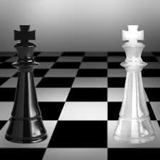
The Western Front
Germany’s invasion of France was stalled when Russia attacked from the east and Britain reinforced France. A stalemate with both sides dug in deep trenches resulted.

Slide 35
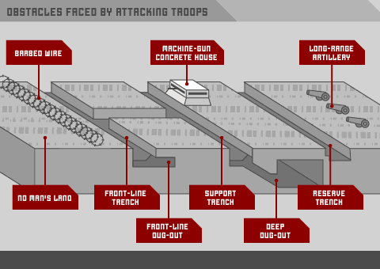
Trench Warfare
Soldiers on both sides dug a vast network of trenches, which included communications, and defenses.

Slide 36
Trench Warfare cont.
Between the two sides lay “no man’s land.”
Soldiers were given the order to go over the top, a charge against the enemy.
Although some ground might be won, it was costly and the counterattack was inevitable.
Tens of thousands of lives were lost over a few hundred yards of territory

Slide 37
Costly Battles
Verdun “They shall not pass!” 500,000 Casualties
Somme River-60,000 British soldiers were killed in one day. 1,000,000 were killed on both sides in 5 months.
New technology made the war more deadly (chart pg 287)

Slide 38
Other European Fronts
Russia
Russia invaded Germany but was pushed back at the battle of Tannenberg.
Russia was poorly equipped and lacked technology, but still continued to send peasant soldiers to their death.
War in the South
Bulgaria joined the Central powers to attack Serbia
Italy joined the Allies to fight against Austria

Slide 39
The War Beyond Europe
War in the Colonies
European colonies in Africa and Asia were battlefronts.
People from India and Africa fought on European battlefields
Many had mixed feelings about fighting for a colonial power

Slide 40
War beyond Europe
Non-European Powers
British, Indian, Australian, and New Zealand fought the Ottoman Empire for control of the Black Sea.
Arab forces backed by the British fought the Ottomans in the middle east.
Japan (a British ally) used the war as an excuse to attack China.
The U.S. tried to remain neutral.

Slide 41
Make Sure You Can Answer
Why did a stalemate develop on the Western Front?
What forces made World War One different from earlier wars?
How did the war become a global conflict?

Slide 42
Make Sure You Can Define
Western Front
No Man’s Land

Slide 43
Winning the War
“You smug faced crowds with kindling eye Who cheer when soldier lads march by, Sneak home and pray, you’ll never know the Hell where youth and laughter go”

Slide 44
Make Sure You Can Answer
How did World War I become a total war?
What role did Women play in the war effort?
What impact did events in Russia and the United States have on World War I?

Slide 45
Make Sure You Can Define…
Women’s Land Army
Edith Cavell
Treaty of Brest-Litovsk
Woodrow Wilson
Fourteen Points
Total war
Propaganda
Atrocity
armistice

Slide 46
Effects of the Stalemate
A modern war required a total war
Each nation but Britain utilized a draft.
Governments took unique steps
Raising taxes
Rationed food
Rationed products like boots and gasoline
Controlled prices
Forbid strikes

Slide 47
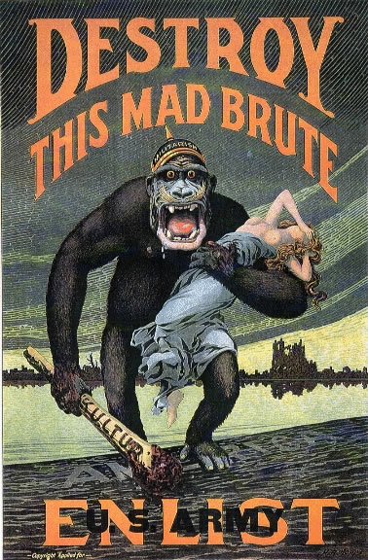
Propaganda War
Governments censored the news, as well as the arts.
Both sides used Propaganda

Slide 48
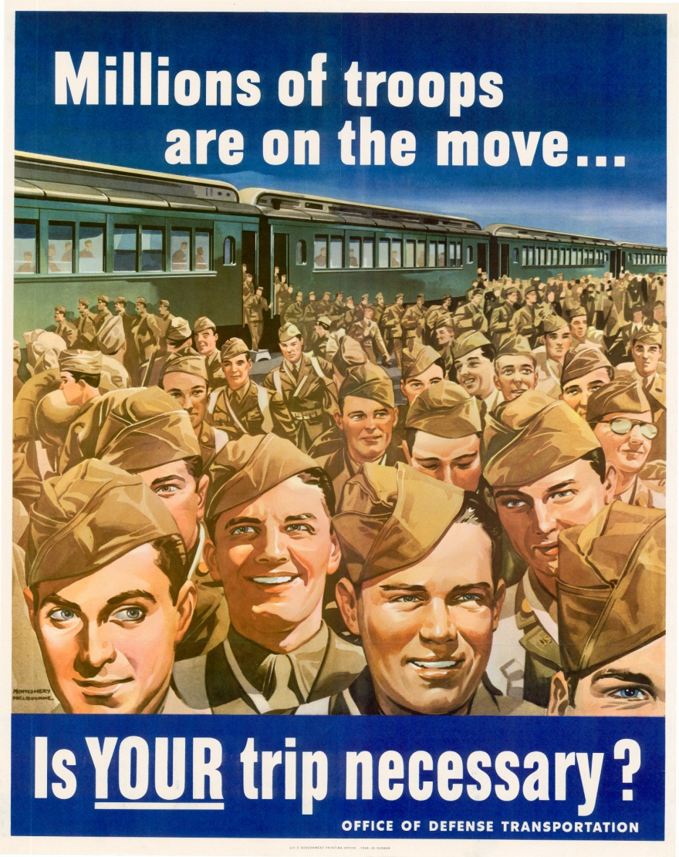
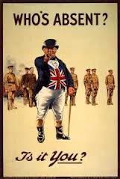
Propaganda

Slide 49
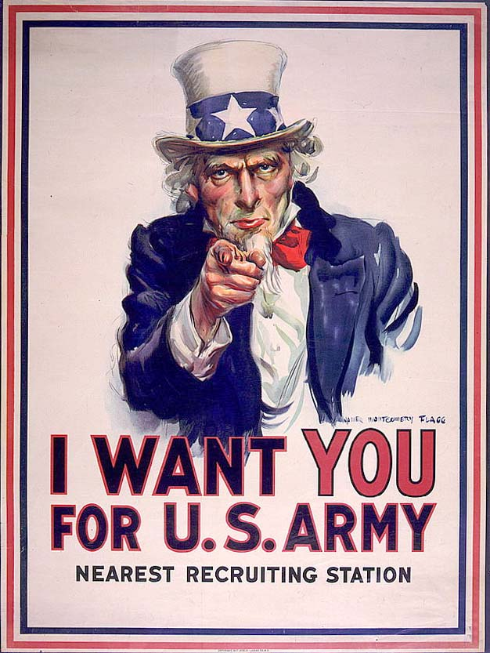
Propaganda

Slide 50
Propaganda
A German song written during World War One…
Hate by water and hate by land, Hate of the head and hate of the hand; We love as one, we hate as one, We have one foe and one alone-ENGLAND”

Slide 51
Propaganda
Both sides accused the other of committing atrocities
Many stories were either exaggerated, some were completely made up.

Slide 52
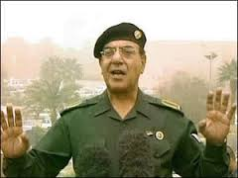
Propaganda
Muhammad Saeed al-Sahhaf
“Any apparent American gains are a cunning ploy by the Iraqis to lure the enemy into a trap. Our armed forces, according to their tactics, are leaving the way open“
"God will roast their stomachs in hell at the hands of Iraqis."

Slide 53
Women at War
Many women took over jobs that had been traditionally done by men. This service would eventually help women in their struggle for equality.
Some women joined women’s branches of the military, such as the British Land Army
At the Front
Women served as nurses, sharing the horror of war with other soldiers
Some women served in secret, such as Edith Cavell, who was killed for helping Allied prisoners escape.

Slide 54
Collapsing Morale
BY 1917 morale was low on both sides
Germany was sending 15 year old soldiers to the front
Britain was almost bankrupt
Some French soldiers mutinied
In Italy, soldiers defected

Slide 55
Revolution in Russia
Stories of incompetent Generals and corruption had left the public furious
The Czar was overthrown in 1917, Vladimir Lenin came to power.
Lenin withdrew the Russians from World War One by signing the Treaty of Brest-Litovsk with Germany.

Slide 56
The United States Enters
Unrestricted Submarine warfare
Germany claimed that they had the right to sink any ship carrying supplies to their enemies, even if the ship also had passengers
Lusitania
Germany sank the Lusitania, killing 1200 passengers, including 128 Americans.
Germany at first agreed to stop, but later resumed unrestricted submarine warfare

Slide 57
Cultural Ties
Many Americans felt a strong feeling of kinship with the British because of a shared culture and language
Some Americans were sympathetic to the French, which was a democracy.
Others felt ties to Germany, and many Irish-Americans opposed the British.

Slide 58
Zimmerman Note
The British intercepted a message from Arthur Zimmerman, the German foreign minister, asking for Mexico to declare war on the U.S
The note promised Mexico that they could have New Mexico, Texas, and Arizona after the U.S was defeated
This note led to a strong Anti-German feeling in the U.S

Slide 59
“The Yanks are coming”
President Woodrow Wilson asked for, and Congress gave permission to send an Army to Europe
The new troops gave the allies a morale boost, as well as needed supplies and money

Slide 60
Over There, Over There
Johnnie, get your gun,
Get your gun, get your gun,
Take it on the run,
On the run, on the run.
Hear them calling, you and me,
Every son of liberty.
Hurry right away,
No delay, go today,
Make your daddy glad
To have had such a lad.
Tell your sweetheart not to pine,
To be proud her boy's in line.

Slide 61
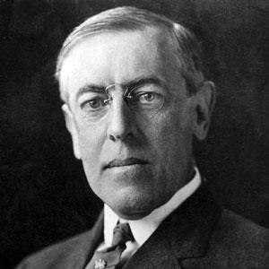
Fourteen Points
January 1918 Woodrow Wilson issued his fourteen points to end this and all future wars
End secret treaties
Freedom of the Seas
Free trade
Large scale reduction of arms
Self-determination for Eastern Europe
Create a general association of nations

Slide 62
Campaign to Victory
Germany launched a huge attack in June of 1918.
The allies launched a counter-attack which pushed the Germans back
The Kaiser stepped down in November of the 1918
Austria-Hungary splintered
The war ended when the Central Powers signed an Armistice on at 11:00 am on 11/11/18

Slide 63
Make Sure You Can Answer
How did World War I become a total war?
What role did Women play in the war effort?
What impact did events in Russia and the United States have on World War I?

Slide 64
Make Sure You Can Define…
Women’s Land Army
Edith Cavell
Treaty of Brest-Litovsk
Woodrow Wilson
Fourteen Points
Total war
Propaganda
Atrocity
armistice

Slide 65
Making the Peace
Tell me what is right, and I will fight for it”
-Woodrow Wilson

Slide 66
Make Sure You Can Answer
What problems did Europeans face in 1918?
How did the Big Three disagree over the peace?
What were the results of the Paris Peace Conference?

Slide 67
Make Sure You Can Define…
David Lloyd George
George Clemenceau
Treaty of Versailles
League of Nations
Reparations
mandate

Slide 68
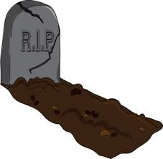
The Co$ts of War
8.5 Million Dead
Around 17 million were wounded, many disabled for life
In 1918, a flu epidemic killed 20 million more

Slide 69
Financial Burdens
All across Europe: homes, farms, factories, roads and churches were destroyed
Many people felt depressed and disillusioned
Citizens from the Allied countries wanted the former Central powers to make reparations.

Slide 70
Political Turmoil
Because of the war; governments had collapsed in Russia, Germany, Austria-Hungary, and the Ottoman Empire
Radicals dreamed of building a socialist society, conservatives warned against communism
With European powers no longer looking invincible, former colonies began to dream of independence

Slide 71
The Paris Peace Conference
The Big Three
Woodrow Wilson- U.S. President, wanted a peace without victory, pressed for his fourteen points
David Lloyd George- British Prime Minister, wanted to rebuild Britain in a way that was “fit for heroes”, a very expensive proposition
Georges Clemenceau- French leader, nicknamed “the tiger” wanted a peace that would weaken Germany.

Slide 72
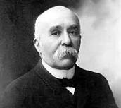
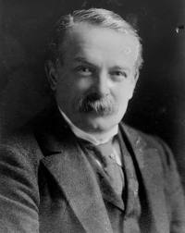
Wilson
Clemenceau
George

Slide 73
Difficult Issues
The “Big Three” took the lead, but many other countries also had competing interests.
Many groups of people who had sided with the allies argued for self-determination.
Since some land was claimed by more than one group of people, it was impossible to satisfy everyone
Wilson had to abandon many of his fourteen points, however the League of Nations was created, without U.S. involvement.

Slide 74
The Treaty of Versailles
The new German government was forced to sign the Treaty of Versailles, which placed all of the blame for the war on Germany, and required them to pay reparations.
The treaty also required Germany to pay pension for Allied soldiers and their families, weakened the Germany military, returned Alsace and Lorraine to France, and took away German territory.
The Germans were forced to sign the document, but resentment in Germany would last for years (ch. 14)

Slide 75
Other Settlements
Self-determination
Many new countries were created out of land that had been owned by Austria, Germany, and Russia. (Czechoslovakia, Lithuania, Latvia, etc.)
Mandate
Across Asia and Africa, former German colonies were ruled by the Allies, rather than being given independence
Unfulfilled goals
Italy was angry they did not get the land they wanted, Japan was angry they weren’t given China, Russia was upset they lost some of their land.

Slide 76
Hopes for Global Peace
More than 40 nations (not the U.S.) joined the League of Nations
People were hopeful for a lasting peace, but there were more wars coming.

Slide 77
Make Sure You Can Answer
What problems did Europeans face in 1918?
How did the Big Three disagree over the peace?
What were the results of the Paris Peace Conference?

Slide 78
Make Sure You Can Define…
David Lloyd George
George Clemenceau
Treaty of Versailles
League of Nations
Reparations
mandate

