Slide 1
Chapter 7
Growth of Western Democracies

Slide 2
Section Outline
Britain Becomes More Democratic
A Century of Reform
Division and Democracy in France
Expansion of the United States

Slide 3
Britain Becomes More Democratic
“
The removal of this vicious and corrupt system, so far from tending to endanger the constitution, in my opinion, will tend materially to improve and strengthen it”

Slide 4
Make Sure You Can Answer…
Why did Reformers seek to alter Parliament in the 1800s?
What role did political parties play in the Victorian era?
How did Britain achieve universal male suffrage?

Slide 5
Make Sure You Can Define…
Rotten boroughs
Chartism
Benjamin Disraeli
William Gladstone

Slide 6
The United Kingdom

Slide 7
Reforming Parliament
1815-Britain’s democracy was dominated by the House of Lords
Catholics were banned from holding office
In the House of Commons, those who could vote (less than 5%) were heavily influenced by the wealthy.
Any Act of the House of Commons could be vetoed by the House of Lords

Slide 8
Pressure
1820s-Parliament granted Catholics and Non-Anglicans the right to vote
How can Parliament be more representative?
Centers of population had shifted leading to Rotten Boroughs
Areas with little or no population had lots of seats, populous areas had none….

Slide 9
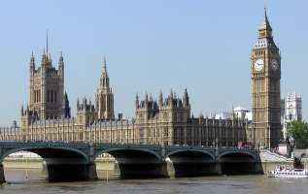
“The Bill, the whole Bill, and nothing but the Bill!”
Reform Bill of 1832
Redistributed seats in the House of Commons, allowed more men to vote
Did not bring full democracy, but rather another step in the right direction

Slide 10
Chartism
Many people believed that the Reform Bill did not go far enough
The protestors drew up the People’s Charter
Universal male suffrage
Secret ballot
Annual Parliamentary elections
Salaries for members of Parliament

Slide 11
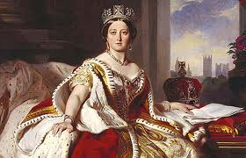
Victorian Age
Queen Victoria Reign from 1837-1901
Embodied the values of her age, called Victorian Ideals
Duty
Thrift
Honesty
Hard work
respectability

Slide 12
Changes under Victoria
Expanded Empire
“The lower classes are becoming so well informed, are so intelligent and earn their bread and riches so deservedly, that they cannot and ought not be kept back”

Slide 13
Politics Transformed
Tories→ Conservatives (Benjamin Disraeli)
Whigs→ Liberals (William Gladstone)
Reform Bill of 1867 passed by the Conservatives, doubled the size of the electorate.
In the 1880s, farmers were given the right to vote under laws passed by the liberals.
Power of the Lords was limited while the power of the middle class increased, eventually the House of Commons became most powerful.

Slide 14
Can you answer?
Why did Reformers seek to alter Parliament in the 1800s?
What role did political parties play in the Victorian era?
How did Britain achieve universal male suffrage?

Slide 15
Can You Define?
Rotten boroughs
Chartism
Benjamin Disraeli
William Gladstone

Slide 16
A Century of Reform
What Social and economic reforms did Britain pass in the 1800s?
How did British women work to win the vote?
What were the goals of the Irish Nationalists?

Slide 17
Economic and Social Reforms
Free Trade
Corn Law Controversy: Should the price of grains be kept high?
Liberals are happy when they are repealed
Abolition of Slavery
1833: All Slavery is banned in Great Britain, but textiles manufacturers still buy cotton produced by slaves in the United States

Slide 18
More Reforms
Crime and Punishment
A limit on capital punishment, and an end to public hangings.
Victories for Workers
1842-Mineowners are forbidden from hiring women or children under 10
1847-Women and children limited to a 10 hour day
Increased Union membership

Slide 19
Other Reforms
Improved Public Health
Public Education
Fabian Society
A group that gradual change through legal means
Growth of the Labour Party
Early 1900s bring about social welfare laws such as insurance and pensions

Slide 20
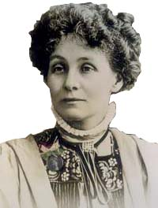
Votes For Women
Emmeline Pankhurst: A leading suffragist who believed that aggressive tactics were needed to get votes for women.
Interrupted Speakers in Parliament
Collected Petitions
When those tactics did not work, they turned to smashing windows and burning buildings
1918-Women in Britain older than 30 are given the right to vote

Slide 21
Ireland
The Irish were ruled by the English, but not happy about it
1829-Catholic Emancipation Act allowed Irish Catholics to vote and hold office. But there were still problems
1845-Great Hunger-one million Irish die of starvation or disease

Slide 22
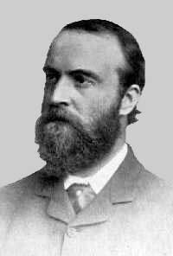
Ireland
Charles Stewart Parnell: Helped Ireland pass a home rule law, but Irish independence was put off until after World War One.

Slide 23
Vocabulary
Corn Laws
Fabian Society
Emmeline Pankhurst
Catholic Emancipation Act
Great Hunger
Charles Stewart Parnell
Home rule

Slide 24
Division and Democracy in France
What domestic and foreign policies did Napoleon III pursue?
What steps toward democracy did the Third Republic take?
What were the results of the Dreyfus affair?

Slide 25
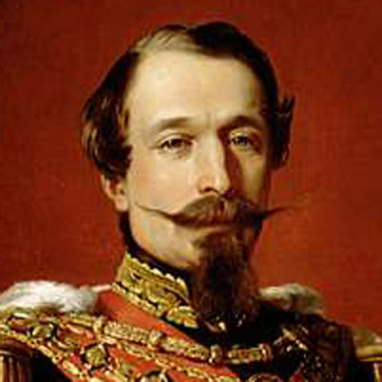
Napoleon III
Came to power in 1848.
Promised to end poverty
Very popular

Slide 26
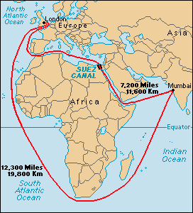
Limits and Growth
Limits on liberty
Managed elections
Limited debate
Strict censorship
Economic Growth
Promoted industry and railroads
Legalized labor unions
Suez Canal

Slide 27
Foreign Affairs
Tried, but failed, to make Mexico a satellite of France
Helped the Italian nationalists defeat Austria
Lost the Franco-Prussian War to Bismarck (remember chapter 6)

Slide 28
The Paris Commune
1871-Rebels who dreamed of a new socialist order took over Paris
National Assembly ordered them to leave, instead a Civil War broke out, leaving 20,000 Communards dead

Slide 29
The Third Republic
Two House Legislature
Chamber of Deputies is the lower house
Senate was the Upper House
Executive power was in the hands of the Prime Minister

Slide 30
Coalition Governments
France had many political parties
Royalists, constitutional monarchists, ultranationalists, moderate republicans, radicals
When enough parties worked together to form a coalition, they elected a cabinet and Prime Minister
Coalition governments are often unstable and can change often
In the first 10 years of the Third Republic, 50 different governments were formed and fell.

Slide 31
Scandals
General Georges Boulanger tried for revenge on Germany, but was forced to flee France
Members of the government were charged with bribery and corruption
The most disturbing and memorable scandal was the Dreyfus affair

Slide 32
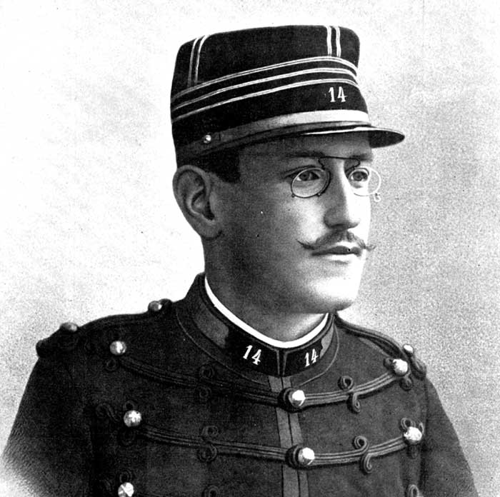
Alfred Dreyfus
The first Jewish soldier to achieve high rank.
Was convicted of spying for Germany based on “secret evidence”
Imprisoned on Devil’s Island off the coast of South America

Slide 33
I Accuse
Ferdinand Esterhazy was spying for the Germans, but he was a member of the nobility.
A newspaper accused the government of wrongly convicting Dreyfus, and after much controversy, there was a new trial
After a second conviction, Dreyfus was pardoned by the French President

Slide 34
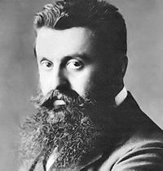
Calls for a Jewish State
1896-Theodor Herzl called for Jews to form their own separate state.
The movement supporting a Jewish country is called Zionism

Slide 35
Reforms in France
Separation of Church and State
A 1905 law separated church and state with the government no longer paying the salaries of church officials
Catholics, Protestants, and Jews all had freedom to worship, but none had special treatment.
Women’s rights
Jeanne Elizabeth Schmahl- Founder of French Union for Women’s Suffrage.
She sought the vote through legal means.

Slide 36
Make sure you can answer
What domestic and foreign policies did Napoleon III pursue?
What steps toward democracy did the Third Republic take?
What were the results of the Dreyfus affair?

Slide 37
Make sure you can define
Paris Commune
Georges Boulanger
Alfred Dreyfus
Theodor Herzl
Jeanne-Elizabeth Schmahl
coalition

Slide 38
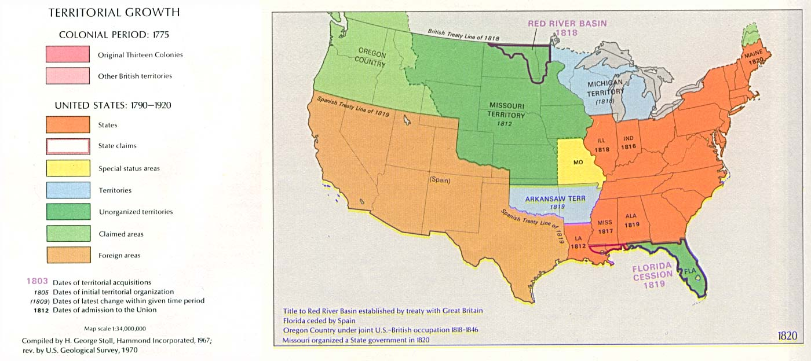
Expansion of the United States

Slide 39
Make Sure You Can Answer
How did the United States expand in the 1800s?
What changes made the United States more democratic?
What were the causes and effects of the Civil War?

Slide 40
From Sea to Sea
Manifest Destiny: The belief that the U.S. will own all of North America
Louisiana Purchase
Florida Cession
Texas Annexation
Mexican Cession
Purchases from Great Britain/Russia
Hawaiian annexation
Move for money and freedom
CA gold Rush
Mormons

Slide 41
Native Americans
As the U.S. expanded, Native tribes were re-located
By force
Through treaty
Most Natives end up living on reservations

Slide 42
Expanding Democracy
Calls for abolition
People like Frederick Douglass ( a former slave), and William Lloyd Garrison (a newspaper publisher) argued against slavery
Women’s rights
Many women, such as Elizabeth Cady Stanton and Lucretia Mott worked hard in the Anti-Slavery movement
When women were not allowed at the world anti-slavery conference, they held the Seneca Falls Convention

Slide 43
Civil War
Abraham Lincoln’s election in 1860 led many Southern states to secede
The Civil War in which the South, after winning many early victories lost, was fought from 1861-1865. More than 600,000 were killed
The Confederate forces fought under Robert E. Lee
The Union was commanded by Ulysses S. Grant

Slide 44
Challenges
After the Civil War, many African Americans faced restrictions like segregation, despite federal laws like the 15th amendment.
African Americans also faced economic hardships. With no land, many had to work as tenant farmers

Slide 45
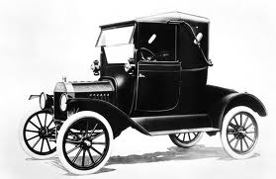
Economic Success
With European capital and natural resources, Industry was very successful
Farm output increased as people migrated west and took advantage of new inventions
Industry grew very fast
Industry led to a new transportation revolution with canals, railroads, and automobiles

Slide 46
Seeking Reform
Labor Unions such as the American Federation of Labor worked to improve the lives of workers. (hours, wages, conditions)
Farmers worked to organize and defend their interests by joining the Populist party

Slide 47
Immigration and Progressives
Millions of immigrants came to the U.S. in the late 1800s and early 1900s
European immigrants settled mainly on the east coast, while Asian immigrants settled mainly on the west coast
Immigrants faced harsh conditions, often living in tenements.
In the west, many Americans pushed to limit Chinese immigration

Slide 48
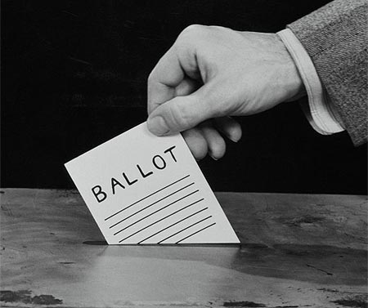
Progressives
Progressives pushed for change such as
A ban on child labor
Limited working hours
Ban on monopolies
Votes for women (gained with the 19th amendment)

Slide 49
Becoming a World Power
By 1900, the U.S. was the world’s leading industrial nation
Many Americans wanted to maintain a policy of isolationism
The U.S. tried, unsuccessfully, to stay out of European affairs

Slide 50
Can You Answer?
How did the United States expand in the 1800s?
What changes made the United States more democratic?
What were the causes and effects of the Civil War?

Slide 51
Can You Define?
Louisiana Purchase
Manifest Destiny
Frederick Douglass
Seneca Falls Convention
Abraham Lincoln
The Fifteenth Amendment
Progressives
Isolationism
Segregation

