Slide 1
The Industrial Revolution Begins
1750-1850

Slide 2
Chapter Outline
Chapter Three
Section One: Dawn of the Industrial Age
Section Two: Britain Leads the Way
Section Three: Hardships of Early Industrial Life
Section Four: New Ways of Thinking

Slide 3
Dawn of the Industrial Age
For Thousands of years people had lived and worked in small farming communities, the Industrial Revolution changed that forever

Slide 4
Make Sure You Can Answer…
What factors contributed to a second agricultural revolution?
Why did populations soar in Europe?
What energy sources powered the Industrial Revolution?

Slide 5
Make Sure You Can Define…
Charles Townshend
Jethro Tull
Robert Bakewell
Thomas Newcomen
James Watt
enclosure

Slide 6
A Turning Point in History
Up until 1750, most people in the world knew only of their own village
They…
Lived in simple cottages lit by fire and candles
Made their own clothes
Grew their own food
Rarely left their hometown
By 1850….
Small villages had grown into big cities
People bought food and clothes in stores
Communicated through telegraph
Traveled great distances
How did this…
Turn into this?

Slide 7
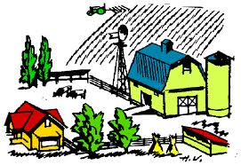
Agricultural Revolution
In the early 1600s farming improved….
Different types of soil was used to improve crop yield
Smaller fields were combined into larger ones

Slide 8
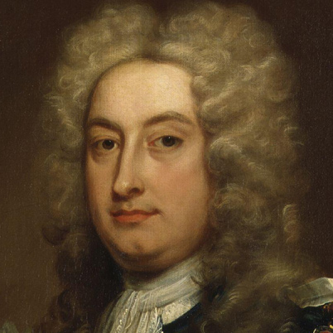
Agricultural Revolution
Charles Townshend
Urged farmers to grow turnips, which would replenish the nutrients in the soil.

Slide 9
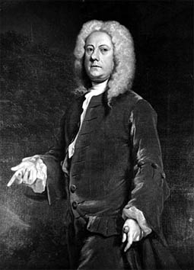
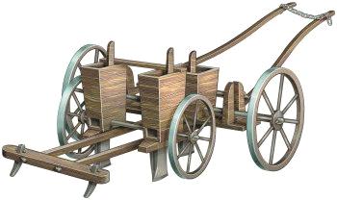
Agricultural Revolution
Jethro Tull
Invented the Seed Drill, deposited seeds in rows instead of scattering them.

Slide 10
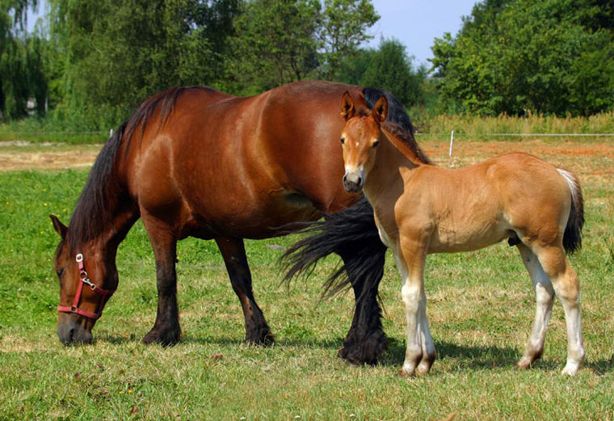
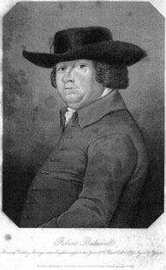
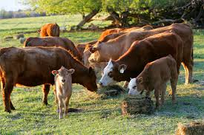
Agricultural Revolution
Robert Bakewell
Bred stronger horses and fatter cattle

Slide 11
Agricultural Revolution
Enclosure movement
Rich landowners took over and fenced off land that had been worked by peasants.
The land could now be worked more efficiently, as farm output rose
Many people lost their jobs and were forced to move to the cities to find work in the growing industry there.

Slide 12
Population Explosion
Britain’s population almost doubled from 1700 to 1800
France’s population increased by 9 million people
Europe’s population grew by 70 million!
WHY?????
Better and more plentiful food
Diseases like bubonic plague were gone
Better hygiene and sanitation
Improved medical care

Slide 13
An Energy Revolution
Giant water wheels powered factories
People then discovered new sources of energy….

Slide 14
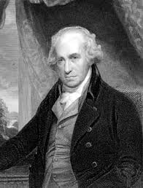
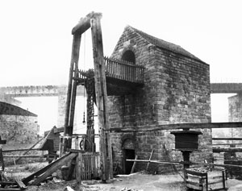
An Energy Revolution
Thomas Newcomen
Developed a steam engine powered by coal that could run factories in 1712.

Slide 15
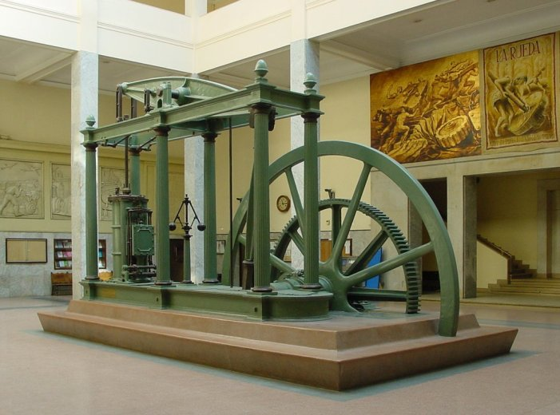
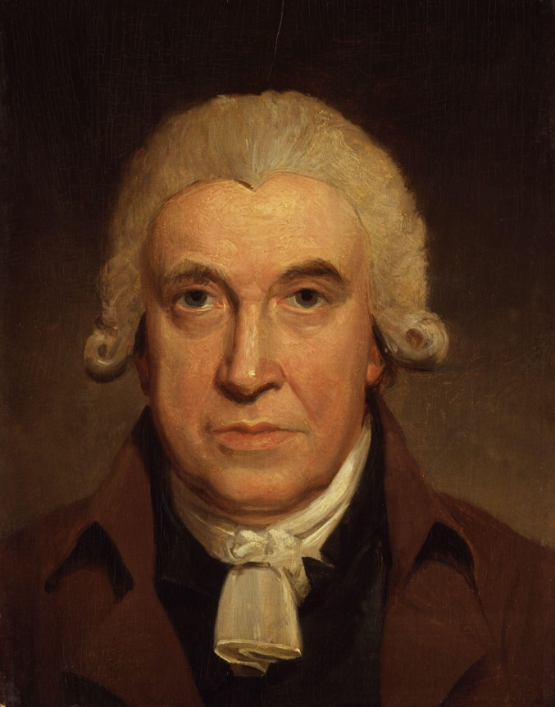
An Energy Revolution
James Watt
Developed an improved steam engine in 1769

Slide 16
Make Sure You Can Answer…
What factors contributed to a second agricultural revolution?
Why did populations soar in Europe?
What energy sources powered the Industrial Revolution?

Slide 17
Make Sure You Can Define…
Charles Townshend
Jethro Tull
Robert Bakewell
Thomas Newcomen
James Watt
enclosure

Slide 18
Britain Leads the Way
“…lo the giant aisles Rich in Model and design;
Harvest tool and husbandry,
Loom and wheel and enginery,
Secrets of the Sullen mine
Steel and Gold, and coal and wine
Fabric rough or fairy fine…
And shapes and hues of art divine!
All of beauty, all of use
That one fair planet can produce”

Slide 19
Make Sure You Can Answer…
Why was Britain the first nation to industrialize?
Why were coal and iron important to the industrial age?
How did industrialization change the textile industry?

Slide 20
Make Sure You Can Define…
Abraham Darby
John Kay
James Hargreaves
Richard Arkwright
Robert Fulton
Factory
turnpike

Slide 21
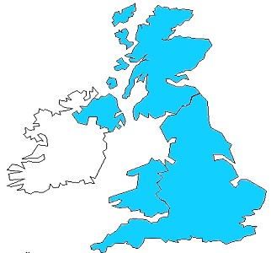
Why Britain?
Resources: Britain had an abundance of……
Natural Resources
Human Resources
New Technology
Britain had favorable social, political, and economic conditions

Slide 22
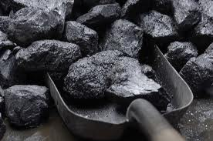
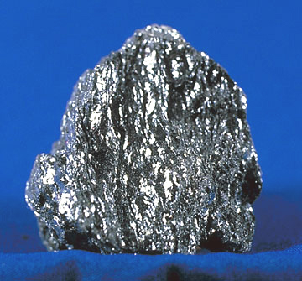
Why Britian?
Natural resources
Britain had a large amount of two important natural resources
1. Coal: The fuel that powered the steam engines
2. Iron: The material that built the new machines

Slide 23
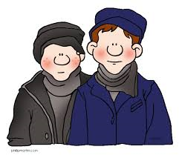
Why Britain?
Human Resources
The agricultural revolution (section one) led to a large number of people needing work.
The population boom increased the workforce even more.

Slide 24
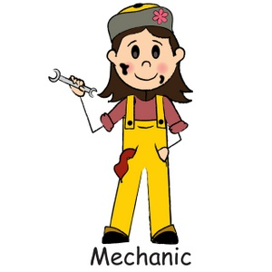
Why Britain?
New Technology
Britain had been at the center of the scientific revolution and the Enlightenment
Britain had lots of skilled mechanics eager to produce practical inventions

Slide 25
Why Britain?
Economic Conditions
Capital
Due to its large overseas empire, the business class had a great deal of wealth to invest
Demand
The population explosion led to a greater demand for goods, as did general economic prosperity.

Slide 26
Why Britain?
Political Conditions
Britain had a stable government, a strong navy, and an upper class that did not resent new economic growth
Social Conditions
Many entrepreneurs came from religious groups that valued thrift and hard work.
For those to whom religion was not important, they dedicated their time improving their business.

Slide 27
The Age of Iron and Coal
Iron was needed to produce steam engines and machines
The process of removing the iron from the rock is called smelting

Slide 28
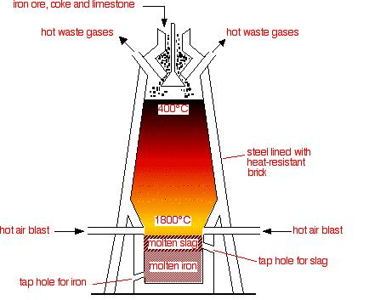
The Age of Iron and Coal
Smelting

Slide 29
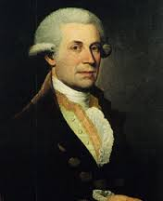
The Age of Iron and Coal
Abraham Darby began to use coal, instead of wood, in the smelting process.
His methods led to better quality and cheaper iron.

Slide 30
Revolutionary Changes in the Textile Industry
The early industry
In the early 1600s cotton cloth from India was very popular
Production in Britain started as raw cotton was given to peasants who spun the cotton into cloth
This process was slow and inefficient.

Slide 31
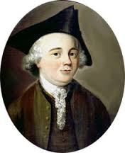
Revolutionary Changes in the Textile Industry
John Kay
Invented the flying shuttle
Helped speed up production
Wove cloth very fast

Slide 32
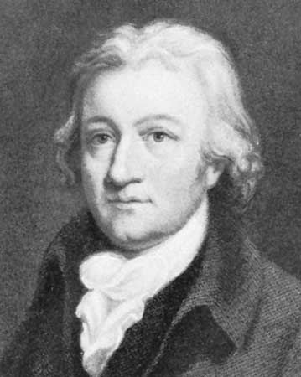
Revolutionary Changes in the Textile Industry
James Hargreaves
Invented the spinning Jenny
Produced cloth even faster

Slide 33
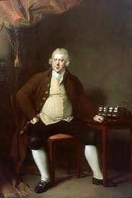
Revolutionary Changes in the Textile Industry
Richard Arkwright
Inventor of the water frame
Made the spinning process even faster by using water power.

Slide 34
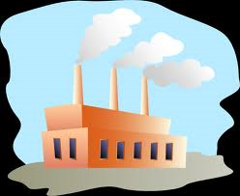
Revolutionary Changes in the Textile Industry
The first factories
Manufacturers needed large buildings to house the new factories
The buildings were at first build near rapidly moving streams in order to harness the power from the water.
Later, steam powered the machines.
The buildings were called factories

Slide 35
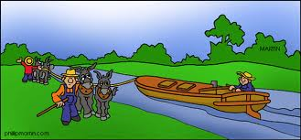
Revolution in Transportation
As goods were manufactured, people needed a quick way to get them to market
Turnpikes and canals were built

Slide 36
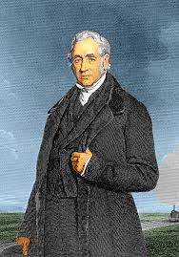
Revolution in Transportation
On Land
George Stephenson developed the steam powered locomotive.

Slide 37
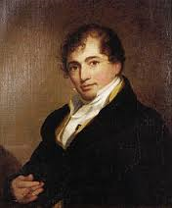
Revolution in Transportation
On Sea
Robert Fulton put James Watt’s steam engine on a boat to create the world’s first steamship
By the late 1800s steamships could carry 10 to 20 times the amount of cargo that wooden ships could.

Slide 38
Looking Ahead
The Industrial revolution triggered a chain reaction..
The supply of goods increased…prices fell… lower prices meant more people could by the goods…which meant more demand…

Slide 39
Make Sure Can Answer…
What factors contributed to a second agricultural revolution?
Why did populations soar in Europe?
What energy sources powered the Industrial Revolution?

Slide 40
Make Sure You Can Define…
Abraham Darby
John Kay
James Hargreaves
Richard Arkwright
Robert Fulton
Factory
turnpike

Slide 41
Hardships of Early Industrial Life
“It was a town of machinery and tall chimneys, out of which interminable serpents of smoke trailed themselves forever and ever…It had a black canal in it, and a river that ran purple with ill smelling dye. It was inhabited by people who went in and out at the same hours…to do the same work, and to whom every day was the same as yesterday and tomorrow, and every year the same counterpart of the last and the next”

Slide 42
Make Sure Can Answer…
How did the factory system change worker’s lives?
What problems did the industrial working class face?
What were the costs and benefits of the Industrial Revoltution?

Slide 43
Make Sure You Can Define…
Luddite
John Wesley
Methodism
urbanization

Slide 44
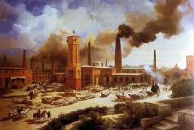
The New Industrial City
The Industrial Revolution brought rapid urbanization. Why?
Small towns grew into large cities almost overnight
Manchester went from 17,000 people in 1750 to 70,000 in 1801
The new industry also brought pollutants…

Slide 45
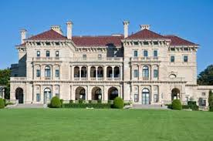
The New Industrial city
In industrial cities there was a big divide between wealthy and poor.
The wealthy lived in big houses in pleasant neighborhoods.

Slide 46
The New Industrial city
The poor working class lived in crowded apartments in crowded neighborhoods.
No running water
Very little light
No sewage or sanitation
Streets littered with garbage and human waste
Disease spread rapidly

Slide 47
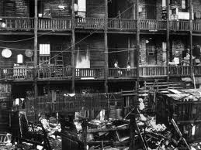
The New Industrial city

Slide 48
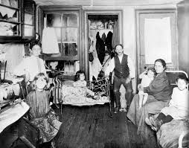

Slide 49
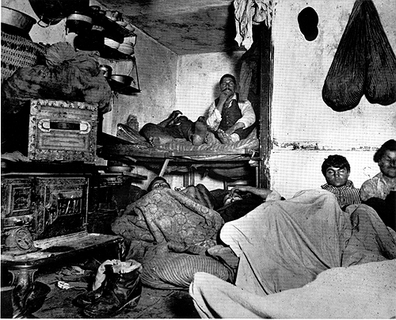
The New Industrial city

Slide 50
The Factory system
Rigid discipline
One shift in a factory lasted 12-16 hours
The school day lasts around 6 hours…and we have breaks!
There were lots of accidents, workers lost fingers, limbs, sometimes their lives
The air was filled with coal dust or cotton lint, which damaged workers lungs.

Slide 51
The Factory system
Women workers
Many of the employees in factories were women
Factory owners preferred women as workers because they could pay them less
Factory worked presented special challenges for women, who were still expected to cook, clean and care for the family while working 12-16 hour days.

Slide 52
The Factory System
Child Labor
Parents accepted the idea of children in factories because they had been helping with farm work.
Parents believed that child labor was necessary because the income was needed.
Often children, like their parents, were treated as slaves.

Slide 53
Patience Kershaw
Patience was 17 years old and a worker in the coal mines.
Her father had died, leaving her mom to raise 10 children, all of whom worked in industry
Patience had the job of pushing carts of coal to the surface of the mine
If she did not push the cart fast enough, she was beaten.

Slide 54
Patience Kershaw
“My father has been dead about a year. My mother has 10 children, 5 lads and 5 lasses. The oldest is about 30, the youngest is 4. Three lasses go to the mill. All the lads are coal miners.”
Out of 10 children, how many worked in the mill?

Slide 55
Patience Kershaw
“I go to the mine at 5 o’clock in the morning and come out at 5 in the evening…I hurry in the clothes I have now got on, trousers and ragged jacket. The bald place upon my head is made by pushing the carts. I hurry the carts a mile more underground and back. I wear a belt and chain…to get the corves out.”
If you were in the government, what would be your biggest concern about the working conditions?

Slide 56
Patience Kershaw
Because of testimony from Patience, the British government began the process of regulating child labor in mines and factories.

Slide 57
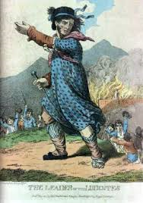
The Working Class
Protests
As new machines and “labor-saving” devices were invented, workers revolted. Why?
Protestors smashed machines and burned factories
Protestors were called Luddites, after mythical figure Ned Ludd
Repression
Protestors were sometimes killed
Labor Unions and strikes were outlawed

Slide 58
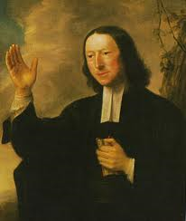
The Working Class
Spread of Methodism
John Wesley started the church
Methodism stressed adopting sober, moral ways

Slide 59
The Working Class
Methodist church services featured hymns and sermons promising forgiveness and a better life to come.
Methodist preachers went into slums and started Sunday schools
Methodists helped workers channel their anger into social reform.

Slide 60
The New Middle Class
Who were they?
Merchants who invested their profits
Inventors
Skilled artisans
How did they live?
Solid, well furnished homes
Well dressed
Active politically

Slide 61
The New Middle Class
Women
Encouraged to behave as “ladies
Took up activities such as drawing or piano playing
Did not work outside the home
Hired a maid to do the housework
Values
The middle class valued hard work and determination
Were sometimes critical of the poor, thinking they were too lazy to become successful

Slide 62
Benefits and Problems
New goods reach more people
More opportunity for wealth
Increased travel brought people closer together.
Low pay
Dismal living conditions
unemployment
Benefits
Problems

Slide 63
Make Sure You Can Answer…
What factors contributed to a second agricultural revolution?
Why did populations soar in Europe?
What energy sources powered the Industrial Revolution?

Slide 64
Make Sure You Can Define…
Luddite
John Wesley
Methodism
urbanization

Slide 65
New Ways of Thinking
“The power of population is far greater than the power of the Earth to provide subsistence for man.” –Thomas Malthus

Slide 66
Make Sure You Can Answer…
What economic ideas helped shape the industrial age?
What reforms did individual thinkers urge?
How was socialism linked to the Industrial Revolution?

Slide 67
Make Sure You Can Define…
Thomas Malthus
Iron law of wages
John Stuart Mill
Utopians
The Communist Manifesto
Socialism
Communism
Proletariat
utilitarianism

Slide 68
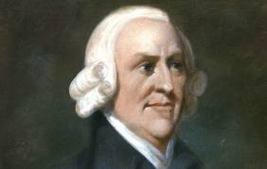
Laissez-Faire Economics
Adam Smith
Believed the free market would help everyone
Goods would cost less and be more available
The more the economy grew, the more people would reienvest

Slide 69
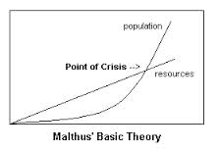
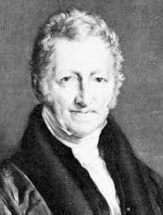
Laissez-Faire Economics
Thomas Malthus

Slide 70
Laissez-Faire Economics
Thomas Malthus’ Theory
If the population kept increasing, there would not be enough food, and the poor would suffer.
The only checks on population were war, famine, and disease.
Opposite view
As the population grew, so too did the food supply.
As the century progressed, living conditions improved.
In the 1900s, population was not a problem in the west, but was a problem in other parts of the world.

Slide 71
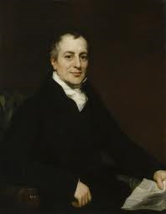
Laissez-Faire Economics
David Ricardo
Agreed with Malthus, developed a theory called the “Iron law of wages”
Ricardo argued that the bigger the population, the lower wages would be for the working class.

Slide 72
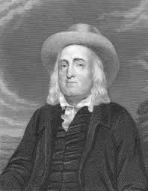
The Utilitarians
Thinkers like Jeremy Bentham were called utilitarians, believing the goal of society should be the greatest good for the greatest number of people.

Slide 73
This is kind of weird….
“My body I give to my dear friend Doctor Southwood Smith to be disposed of in a manner hereinafter mentioned, and I direct ... he will take my body under his charge and take the requisite and appropriate measures for the disposal and preservation of the several parts of my bodily frame in the manner expressed in the paper annexed to this my will and at the top of which I have written Auto Icon. The skeleton he will cause to be put together in such a manner as that the whole figure may be seated in a chair usually occupied by me when living, in the attitude in which I am sitting when engaged in thought in the course of time employed in writing. I direct that the body thus prepared shall be transferred to my executor. He will cause the skeleton to be clad in one of the suits of black occasionally worn by me. The body so clothed, together with the chair and the staff in the my later years bourne by me, he will take charge of and for containing the whole apparatus he will cause to be prepared an appropriate box or case and will cause to be engraved in conspicuous characters on a plate to be affixed thereon and also on the labels on the glass cases in which the preparations of the soft parts of my body shall be contained ... my name at length with the letters ob: followed by the day of my decease. If it should so happen that my personal friends and other disciples should be disposed to meet together on some day or days of the year for the purpose of commemorating the founder of the greatest happiness system of morals and legislation my executor will from time to time cause to be conveyed to the room in which they meet the said box or case with the contents therein to be stationed in such part of the room as to the assembled company shall seem meet.”
http://www.ucl.ac.uk/Bentham-Project/who/autoicon/Virtual_Auto_Icon

Slide 74
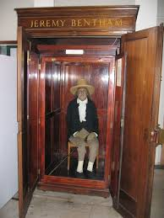
This is extraordinarily weird…

Slide 75
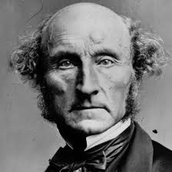
Utilitarians
Bentham’s chief follower was John Stuart Mill
Mill argued that actions were right if they caused happiness, and wrong if they caused pain.
Mill did not believe that an unrestricted free market was good, instead he wanted government intervention.

Slide 76
Emergence of Socialism
Under Socialism the people as a whole, rather than private individuals would own the means of production.
In Winthrop, people own their own homes private ownership, but the town as a whole owns Winthrop High School.
Socialism believed in the basic goodness of human nature, and its goal was a society that operated for the welfare of all.

Slide 77
Emergence of Socialism
Utopians
Early socialists wanted to build self sufficient communities where all work was shared and all property held in common
Robert Owen
A successful mill owner from Wales, Owen refused to use child labor.
He built a factory in a town called New Lanark Scotland.
Showed that an employer could make a profit while still caring for his employees.

Slide 78
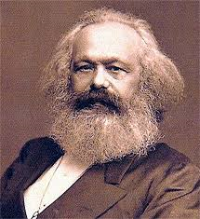
The “Scientific Socialism” of Karl Marx
Karl Marx was a German Philosopher who claimed his theory was based on science
Marx wrote The Communist Manifesto along with Friedrich Engels

Slide 79
The “Scientific Socialism” of Karl Marx
Marxism
Marx believed the economics was the driving force behind history-all of history was a struggle between those who had (bougeoisie), and those who had not (proletariat).
Marx predicted the proletariat would revolt and take control of the means of production, resulting in a society of equality without classes.
Marx thought capitalism was evil.

Slide 80
The “Scientific Socialism” of Karl Marx
Impact
At first Marxism had very little impact
As time went on, European socialists embraced Marxism, hoping for a classless society
In the late 1800s, Marxists emerged and eventually took control of Russia

Slide 81
The “Scientific Socialism” of Karl Marx
Weaknesses
Marx believed his ideas to be based on science, but time proved many of his theories wrong.
For example, Marxism lost some of its appeal as the industrial revolution led to a worldwide increase in the standard of living.
Also, Marx was incorrect in believing that workers would unite across borders. Instead, nationalism won out over class loyalty.

Slide 82
Make Sure you Can Answer…
What economic ideas helped shape the industrial age?
What reforms did individual thinkers urge?
How was socialism linked to the Industrial Revolution?

Slide 83
Make Sure you Can Define…
Thomas Malthus
Iron law of wages
John Stuart Mill
Utopians
The Communist Manifesto
Socialism
Communism
Proletariat
utilitarianism

