Slide 1
Lawrence Kohlberg
Founder of “moral development psychology” (the idea that morality can be taught and improved).
Earned his college degree in just one year!
Used interviews and dilemmas to conduct his research.
Contracted a parasitic infection in Belize c. 1970.
Intense pain and discomfort for 15 years…
Disappeared from Mt Auburn Hospital 17 Jan 87.
Car found at the south end of Winthrop St. on 19 Jan.

Slide 2
Basic Theory:
Most people do “the right thing” most of the time… the key question is WHY they do the right thing.

Slide 3
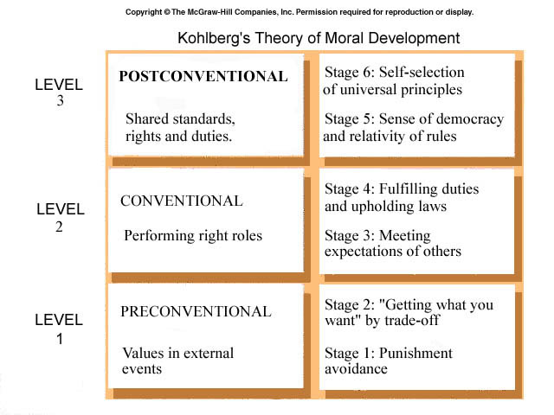
Universal
Global
Local/State
Family
“Quid pro quo”

